Slide 1
Australasian Association of Irlen Consultants

Slide 2
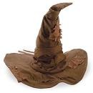

DSM5 Diagnostic Criteria for Autism

Slide 3
Criterion A:
Persistent deficits in social communication and social interaction across contexts, manifested by all three of the following:
Deficits in social-emotional reciprocity; ranging for example, from abnormal social approach and failure of normal back and forth conversation to reduced sharing of interests, emotions, or affect; to failure to initiate or respond to social interactions

Slide 4
Deficits in non-verbal communicative behaviours used for social interaction; ranging from poorly integrated verbal and nonverbal communication, to abnormalities in eye contact and body-language, or deficits in understanding and use of gestures, to a total lack of facial expressions and non-verbal communication.
Deficits in developing, understanding and maintaining relationships, ranging for example, from difficulties adjusting behaviour to suit various contexts: to difficulties sharing imaginative play or in making friends; to absence of interest in peers.
Specify current severity

Slide 5
Criterion B:
Restricted, repetitive patterns of behaviour, interests, or activities as manifested by at least two of the following:
Stereotyped or repetitive motor movements, use of objects or speech; (such as simple motor stereotypes, lining up toys or flipping objects, echolalia, or idiosyncratic phrases).

Slide 6
Criterion B:
Insistence on sameness, inflexible adherence to routines or ritualized patterns of verbal or nonverbal behaviour, or excessive resistance to change; (e.g., extreme distress at small changes, difficulties with transitions, rigid thinking patterns, greeting rituals, need to take the same route, or eat the same food every day).

Slide 7
Criterion B:
Highly restricted, fixated interests that are abnormal in intensity or focus; (e.g., strong attachment to or preoccupation with unusual objects, excessively circumscribed or perseverative interests).
Hyper- or hypo-reactivity to sensory input or unusual interest in sensory aspects of environment; (e.g., as apparent indifference to pain/temperature, adverse response to specific sounds or textures, excessive smelling or touching of objects, visual fascination with lights or movement).
Specify current severity

Slide 8
Hyper- or hypo-reactivity to sensory input or unusual interest in sensory aspects of environment
Central characteristic of ASD
Assessment tools and therapy strategies
Occupational Therapist and psychologist

Slide 9
Hyper- or hypo-reactivity to sensory input or unusual interest in sensory aspects of environment
Lifelong characteristic
In the adult years may be able to avoid or minimize exposure to specific sensory experiences and learn to tolerate and endure the experience
Repeated exposure does not automatically lead to reduced sensitivity (Penny)

Slide 10
Sensory Sensitivity: Hyper and Hypo Sensitivity
Vision
Hearing
Tactile

Slide 11
Sensory Sensitivity: Hyper and Hypo Sensitivity
Olfactory (smell)
Gustation (taste)
Proprioception (body awareness affecting hunger, pain and toileting skills)
Vestibular system (balance and spatial orientation)

Slide 12
Sensory Sensitivity
Research
Sensory processing in adults with ASD
94% reported extreme levels of sensory processing
Can be reported as early as 6-12 months
Was originally part of the 1980 diagnostic criteria for ASD but not unique to ASD e.g. schizophrenia

Slide 13
Sensory Sensitivity
Smith and Sharp 2013
Concept of sensory avalanche and sensory fascination
Some sensory experiences extremely pleasurable and relaxing
Can lead to abilities, such as attention to detail in art due to visual sensitivity

Slide 14
Visual Acuity
Ashwin et al
Used the Freiburg Visual acuity and Contrast Test
15 adult males with HFA or AS compared to controls
Visual acuity 20:7 So superior it lies in the region reported for birds of prey
Discriminate detail on a object 20 feet away that a typical person can see from 7 feet away

Slide 15
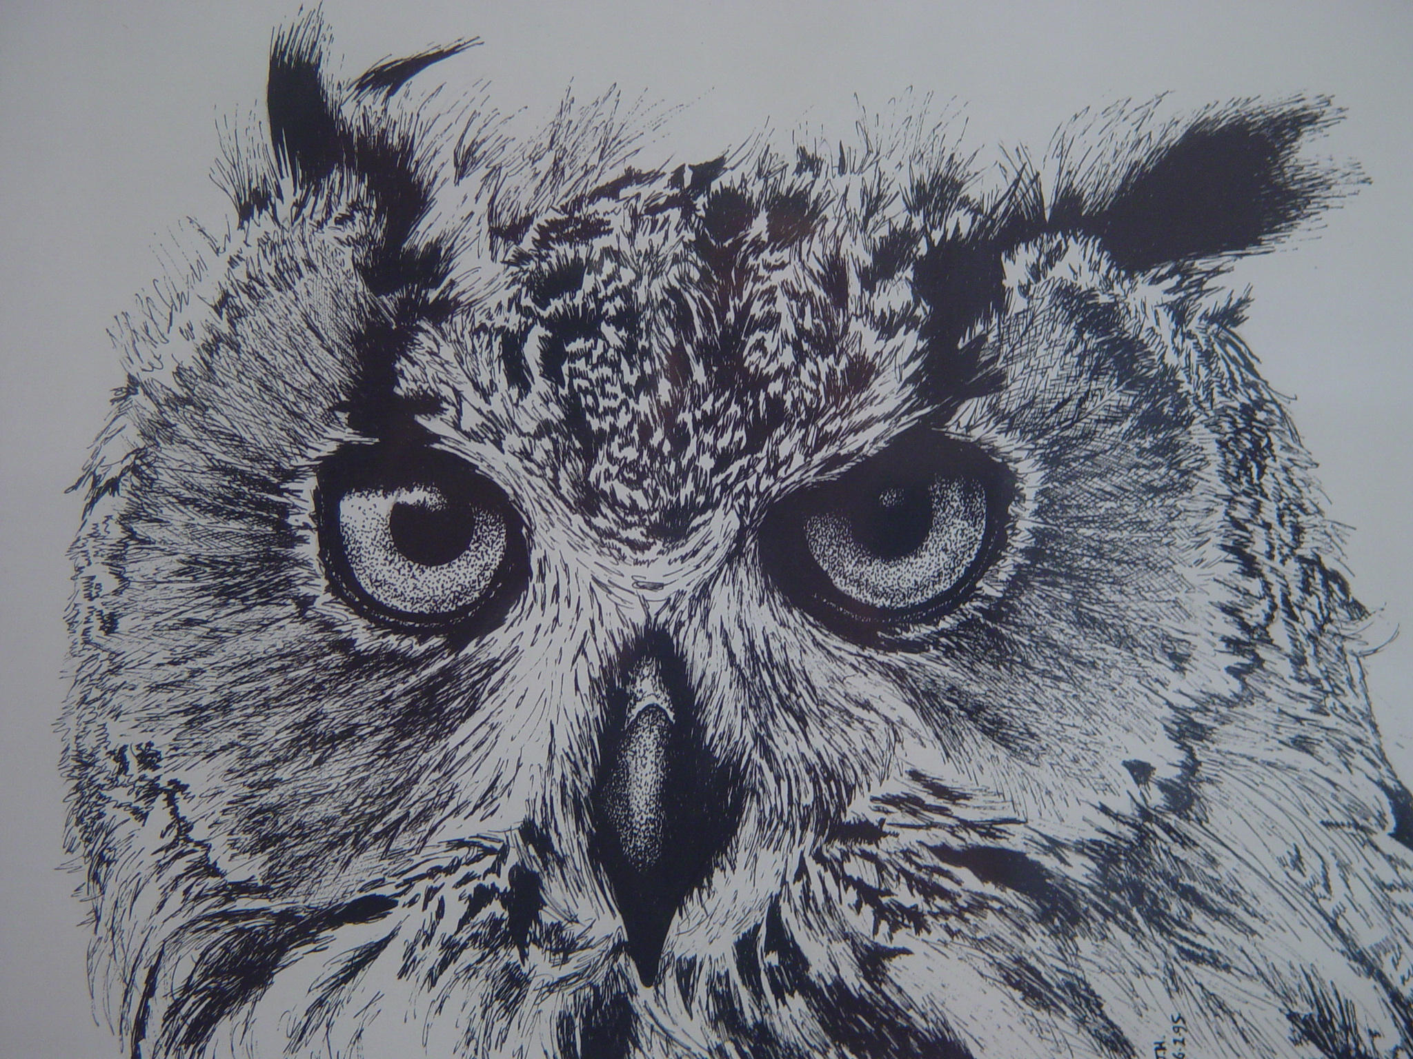

Slide 16
Sensory Subtypes
Ausderan et al: Jr Child Psychol and Psychiatry 55:8
Children with ASD 2-12 years
4 sensory subtypes

Slide 17
Sensory Subtypes
Mild (low scores)
Sensitive-Distressed (enhanced perception)
Attenuated-Preoccupied (higher hypo-reactivity and sensory interests
Extreme mixed (high scores on all measures)

Slide 18
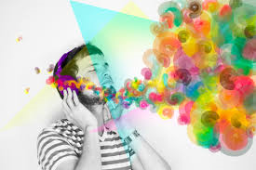
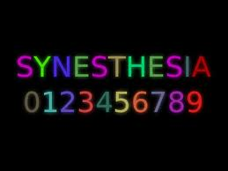
Synaesthesia
Sensation on one sensory modality triggers a perception in a second modality
Adults with ASD, rate of synaesthesia 18.9%, in controls 7.2%
Most common grapheme (written word or symbol triggers a colour) or sound-colour

Slide 19
Visual Sensitivity
Light intensity (squint or wear a baseball cap)
Prefer natural light
‘Blinded’ by reflections
Complex patterns and bright colours can be aversive (or fascinating)
ASD teenage ‘uniform’ dull, subdued colours

Slide 20
Reading
At least one in five children with ASD have a significant problem with reading.
Can be better reading accuracy than comprehension

Slide 21
Reading
Conventional remedial reading programs have not been as effective as with typical children.
Narrow focus (client and width of visual field)
Assessment of perceptual, linguistic and cognitive skills

Slide 22
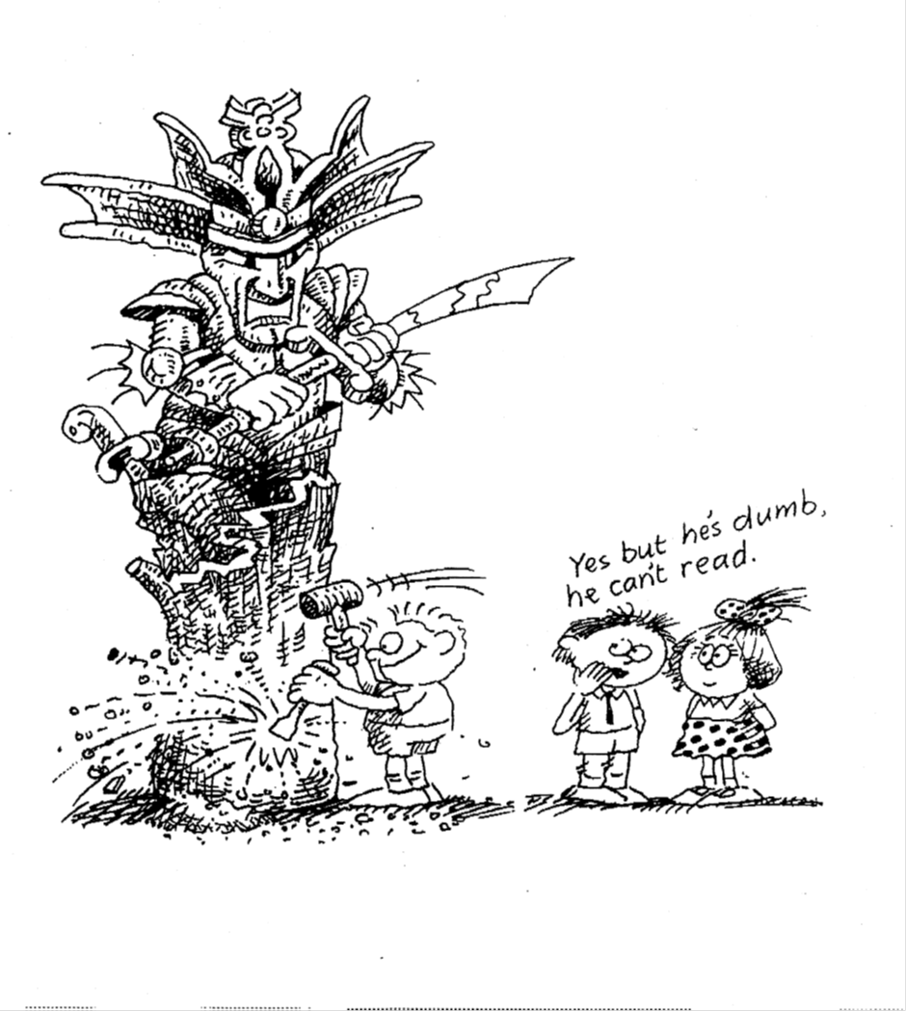
Reading
Effects in the High School years on academic ability and on self-esteem
Need for an early assessment and intervention
Hyper-lexia, to acquire knowledge on a special interest

Slide 23
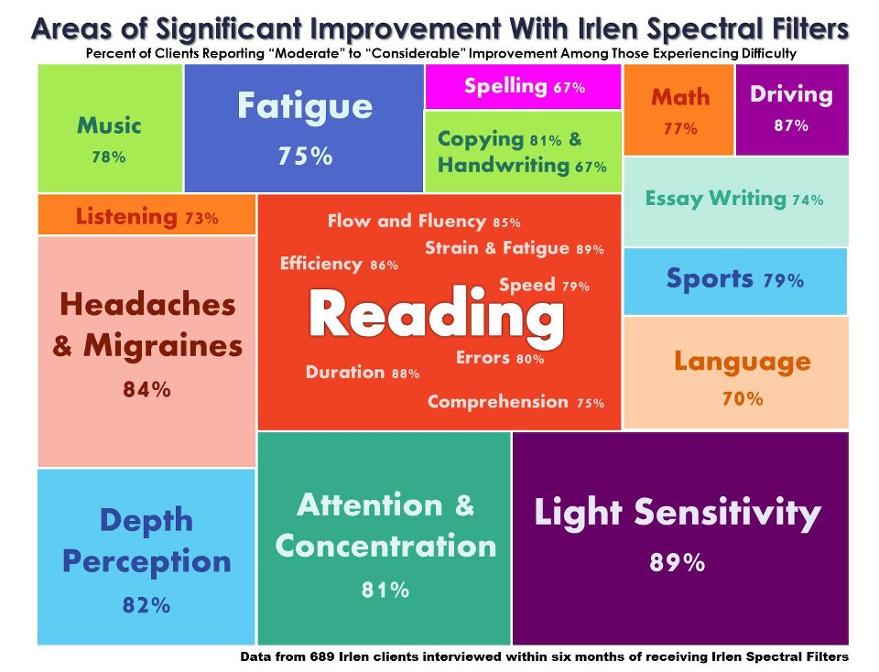

Slide 24
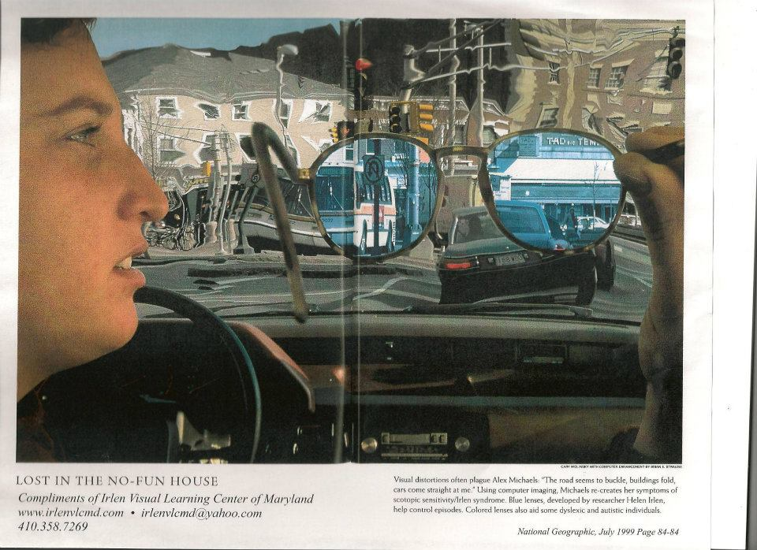

Slide 25
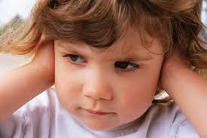
Sound Sensitivity
Johansson
Characteristics of:
Roughness
Loudness
High frequency
Tonality

Slide 26
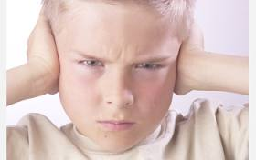
Sensory Sensitivity.
Acute auditory sensitivity to specific sounds (Hyperacusis)
Sudden or ‘sharp’ noises, ( dog barking, coughing, click of a pen top)

Slide 27
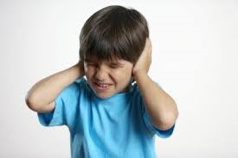
Sensory Sensitivity.
Small electric motors or a specific pitch
Unpredictable sounds, telephones, baby crying

Slide 28
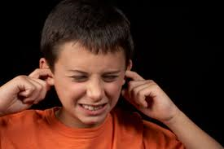
Temple Grandin
“ Sudden loud noises hurt my ears like a dentist’s drill hitting a nerve. High pitched continuous noises such as hair dryers and other small motors are annoying. All the behaviour modification in the world is not going to stop an autistic child from screaming when a noise hurts his ears.”

Slide 29
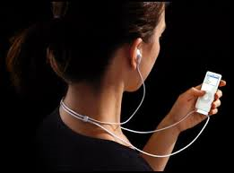
Suggestions to Reduce Auditory Sensitivity
Identify and avoid the sound
Barrier such as ear plugs or noise reducing industrial headphones
Camouflage the perception of the sound with music - iPod

Slide 30
Tactile Defensiveness
Acute sensitivity to specific tactile experiences
Sensitivity to touch and texture on particular parts of the body (scalp, upper arms, palms of hands and soles of feet)

Slide 31
Temple Grandin
“I pulled away when people tried to hug me, because being touched sent an overwhelming tidal wave of stimulation through my body.”
“Church was a nightmare because the petticoats and other Sunday clothes itched and scratched. Many behaviour problems in church could have been avoided by a few simple clothing modifications.”

Slide 32
Stephen Shore
“Haircuts were always a major event. They hurt! To try to calm me, my parents would say that hair is dead and has no feeling. It was impossible for me to communicate that the pulling on the scalp was causing the discomfort.”

Slide 33
Tactile Defensiveness
Gestures of affection perceived as too intense a sensation
Aversion to certain fabrics
Strategies: ‘deep pressure’
Weighted vests and blankets
Sensory Integration Therapy

Slide 34
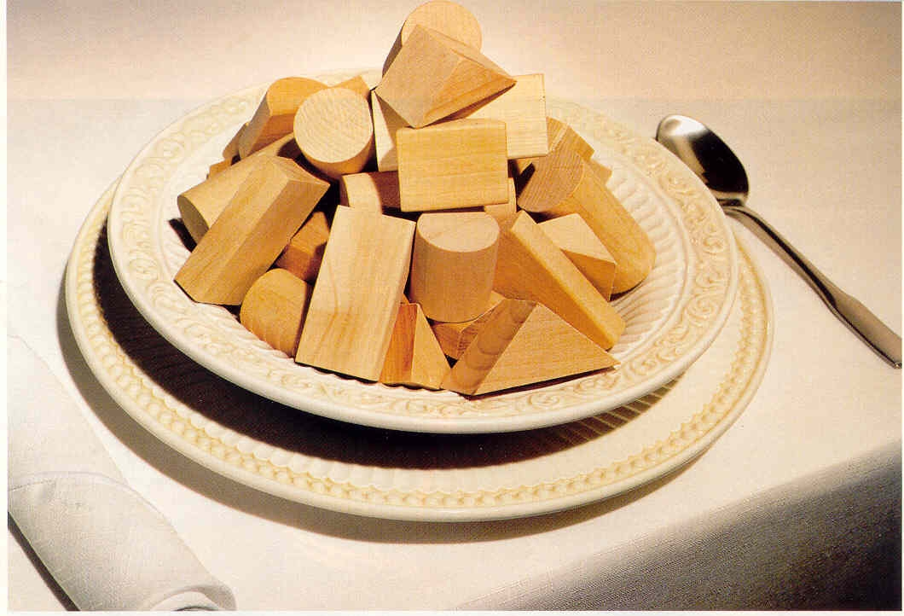
Sensitivity to Food
The smell, taste, aroma, texture, temperature, liquidity, noise, colour

Slide 35
Sean Barron
“I was supersensitive to the texture of food and I had to touch everything with my fingers to see how it felt before I could put it in my mouth. I really hated it when food had things mixed with it. I could never put any of it into my mouth. I knew if I did I would get violently sick.”

Slide 36
Strategies for Sensitivity to Taste and Texture
Check diet and advice from a dietician
What aspect of food is the child sensitive to?
Avoid programs of starvation to encourage a wider range of foods
Avoid programs of force feeding
Accept the unusual diet at mealtimes
Being brave to accept smelling, then on the tongue, then swallowing food that may not be quite so aversive
Lunchbox always the same

Slide 37
Pain and temperature

Slide 38
A World Of Terrifying Sensory Experiences
Hyper-vigilant and ‘shell shocked’
Need a coping or escape mechanism
Self hypnosis, being mesmerized by a repetitive action or sensation

Slide 39
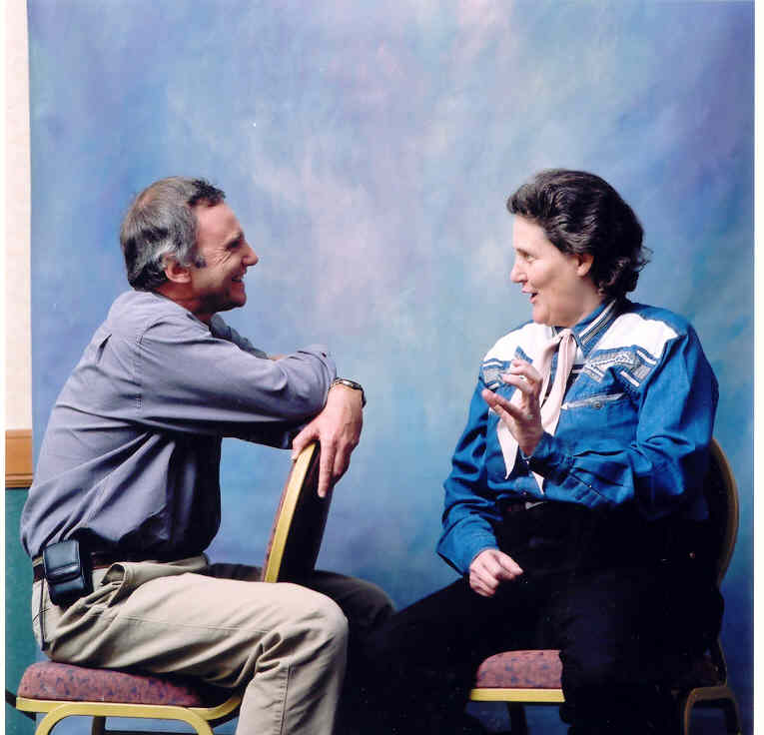
Temple Grandin
“Intensely preoccupied with the movement of the spinning coin or lid, I saw nothing or heard nothing. People around me were transparent and no sound intruded on my fixation. It was as if I was deaf.”

Slide 40
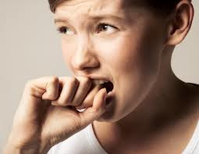
Anxiety

Slide 41
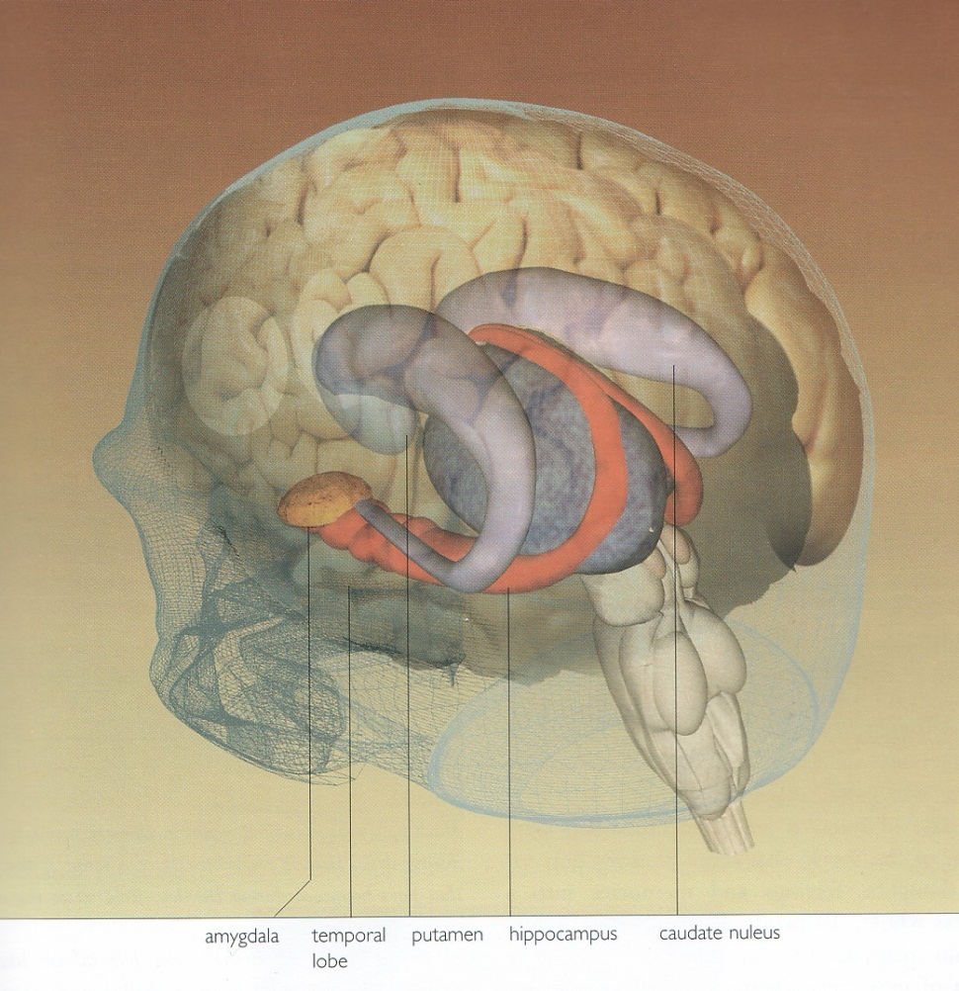
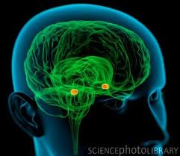
Amygdala

Slide 42
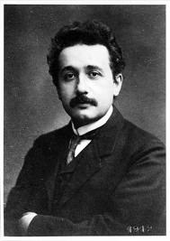
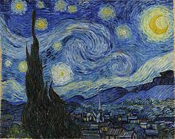
Society’s Perspective
Originality in Science and Art

Slide 43

Talents and Interests
A Tree Growing in a Forest Clearing

Slide 44
Engineering ability
Mathematics and science
Music and fine art
Imagination
Animals

Slide 45
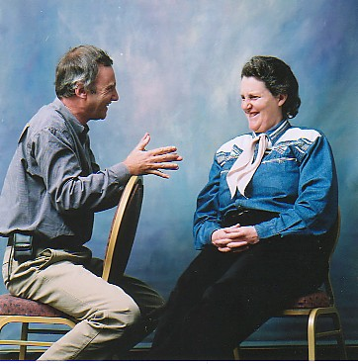
“If the world was left to you socialites, we would still be in caves talking to each other” Temple Grandin

