Slide 1

WHAT TO DO?
Can we do anything?

Slide 2
WHAT DO WE CALL IT?
IRLEN SYNDROME
MEARES-IRLEN SYNDROME
SCOTOPIC SENSITIVITY SYNDROME
VISUAL PROCESSING DISORDER
ANOMALOUS VISUAL PROCESSING
VISUAL PERCEPTION DYSFUNCTION
VISUAL PERCEPTUAL DYSLEXIA
IRLEN DYSLEXIA
LIGHT SENSITIVITY/PHOTOPHOBIA
VISUAL STRESS
VISUAL DISCOMFORT

Slide 3

PROBLEMS WITH HAVING VARIOUS NAMES FOR “IT”
Creates confusion
Reduces credibility
Implies uncertainty

Slide 4
PROBLEMS WITH CALLING “IT” IRLEN SYNDROME/SCOTOPIC SENSITIVITY
Considered a problem with Reading only
Accepted mythology “It doesn’t exist”
Most Health Professionals are not even aware of it
No real interest except by parents who “know there is something holding their child back”
Not everyone is affected significantly
Not seen as a social problem by authorities
Most people “live with it” and don’t even know “things” could be better

Slide 5

PROBLEMS WITH CALLING “IT” LIGHT SENSITIVITY OR PHOTOPHOBIA
Seen as an eyesight problem
Sunglasses or “tinted lenses” are provided
Ophthalmologists and optometrists consider us a threat
Parents advised to go to Behavioural Optometrist by teachers and other Health Professionals

Slide 6
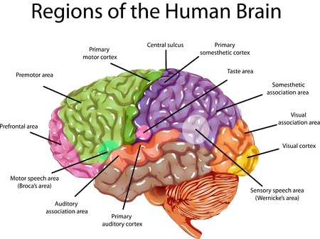
PROBLEMS WITH CALLING “IT” ANOMALOUS VISUAL PROCESSING OR VISUAL PROCESSING DYSFUNCTION (DISORDER)
We KNOW it involves the BRAIN and NOT the EYES…. BUT…
Not considered a MEDICAL problem
(there is no medical treatment)
Not considered a PSYCHOLOGY problem
(there is no psychological treatment)
Not considered an EDUCATION problem
(there is no educational treatment)

Slide 7
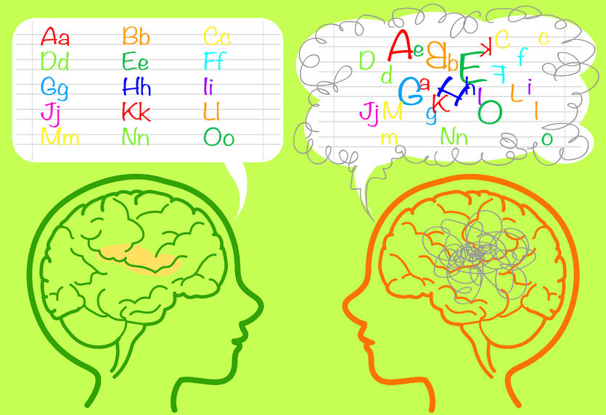
PROBLEMS WITH CALLING “IT” VISUAL DYSLEXIA OR IRLEN DYSLEXIA
The state and national Dyslexia Associations feel they have “ownership” of that term.
They are supported by SPELD in all
states.
They are powerful
They have the government’s “ear”
Dyslexia has negative connotations
It reinforces the idea that Irlen is all to
do with Reading
SPELD used to support Irlen, but not presently.

Slide 8

WOULD MORE RESEARCH HELP?
There are hundreds of research articles on www.Irlen.com
Not all positive, but certainly not all negative.
If a genuine person wanted to look at the research, they could access this list.
It is easier to believe the “myth” that there is no research, or the research is not in peer-reviewed journals.
More research would help, BUT, would it be read by those who are non-believers? Most likely NOT!

Slide 9


PROBLEMS WITH GETTING RESEARCH DONE.
POLITICAL..
Not many, if any, will even consider it BECAUSE they don’t want to be seen as supporting something that everyone knows “does not exist”
All research MUST be done at the University level to even be considered valid.
FUNDING..
Granting bodies are mostly from government sources
Medical grants are sometimes funded by pharmaceutical companies but these lack credibility because seen as having vested interest.
All grants have to be “peer-reviewed” (there are no “peers” doing research on Irlen)

Slide 10

ARE THERE ANY SOLUTIONS?
PUBLICITY… but… WHO to target?
EDUCATION MINISTERS?
HEALTH MINISTERS?
ENERGY MINISTERS?
PREMIERS?
PSYCHOLOGY ASSOCIATIONS?
MEDICAL ASSOCIATIONS?
OPHTHALMOLOGICAL ASSOCIATIONS?

Slide 11





WHAT CAN WE DO?
PRESS RELEASES… Who and where?
Today’s news is tomorrow’s rubbish.
ORGANISED MARCHES…. Organised by whom?
Would require parents to be involved and most are too busy
TESTIMONIALS… to whom?
Usually seen as just one person’s experience
SOCIAL MEDIA….. “biggest bang for your buck”
Facebook
Instagram
Twitter
Pinterest
COMMUNITY GROUPS ON FACEBOOK….
Increases the exposure of Irlen Syndrome to many

Slide 12
HOW TO SURVIVE THE PERCEIVED “THREATS”
ACCEPT THAT WE ARE “OUTSIDE” THE “ESTABLISHMENT”
BE PROFESSIONAL AT ALL TIMES
ALWAYS INVOLVE THE PARENTS/CARERS IN THE PROCESS
BUILD OUR REPUTATION THROUGH “BEST PRACTICE”
BE SEEN AS AN IRLEN “SPECIALIST”
DON’T TRY TO BE “EVERYTHING” TO “EVERYBODY”
DON’T “BADMOUTH” PROFESSIONALS WHO MAY “BADMOUTH” US
BE “ACCEPTING” OF SOME CHILDRENS’ BEHAVIOURS
EXPLAIN THE CAUSE OF IRLEN SYNDROME TO INCREASE UNDERSTANDING
USE SOCIAL MEDIA TO SPREAD THE WORD
TREAT CLIENTS AS YOU WOULD WANT TO BE TREATED YOURSELF
BE PREPARED TO HELP FINANCIALLY THOSE PARENTS WHO NEED IT
PLACE ADVERTISEMENTS IN SCHOOL NEWSLETTERS
ACCEPT A SMALL FINANCIAL LOSS TO ENSURE CLIENTS “COME BACK”

Slide 13
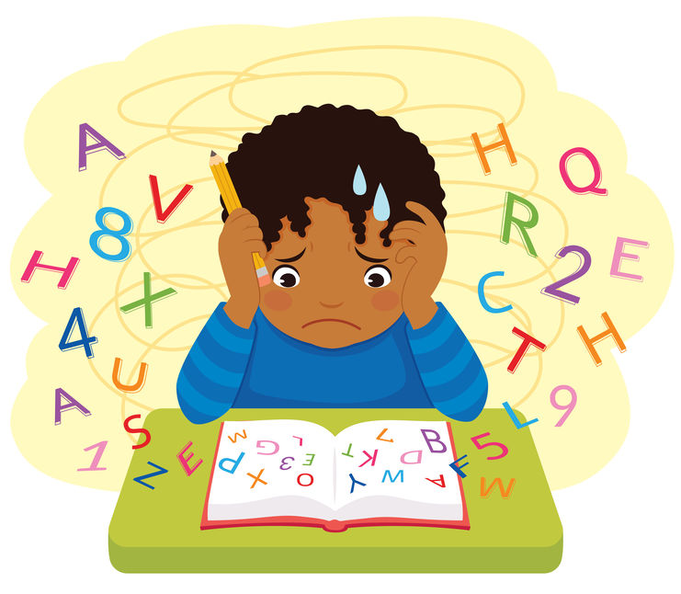




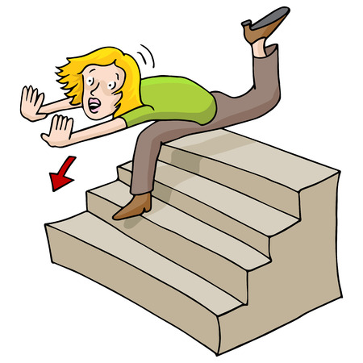


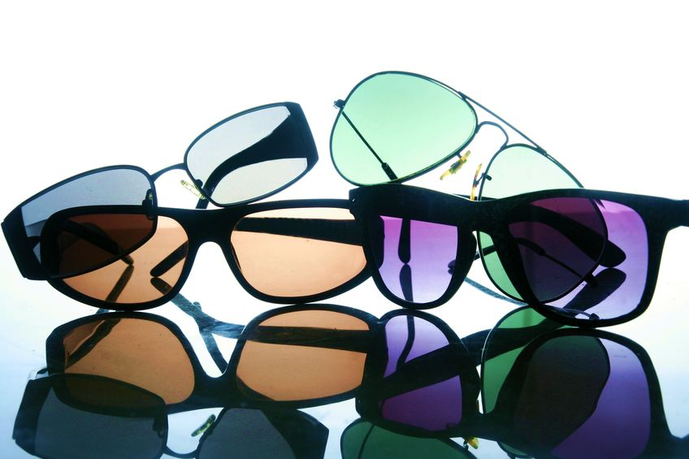
FINALLY… THIS IS WHAT WE ARE ALL ABOUT…..
IRLEN SPECTRAL FILTERS
IRLEN METHOD

