Slide 1


Slide 2
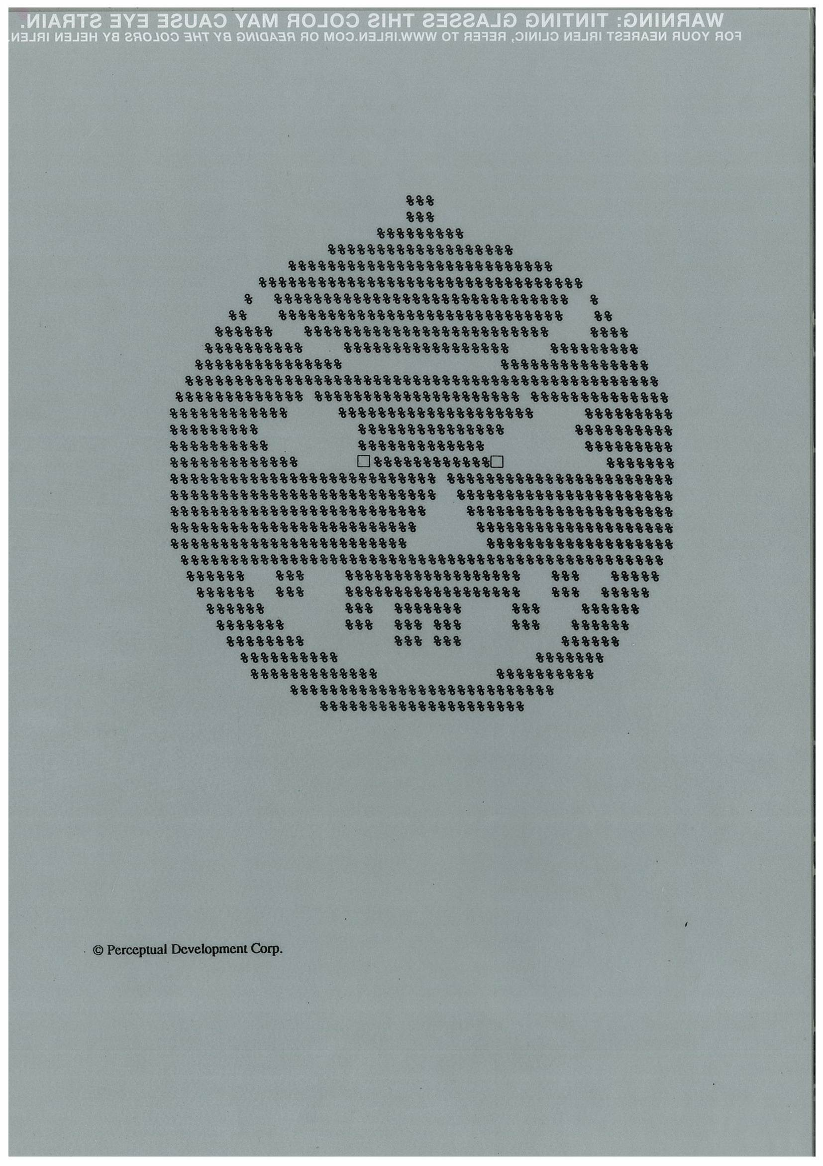

Slide 3
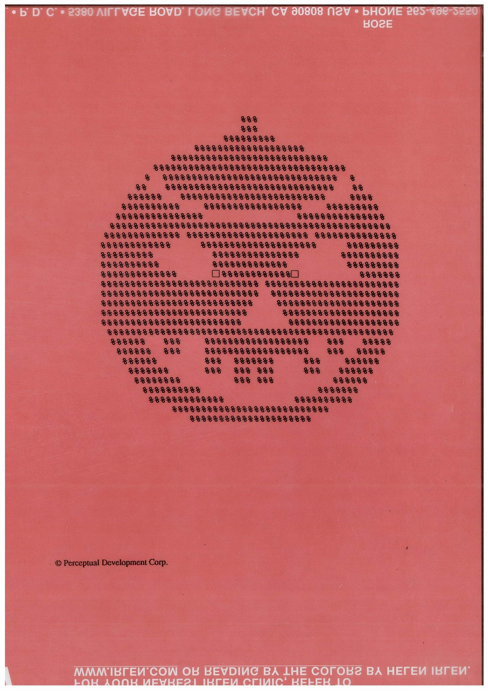

Slide 4
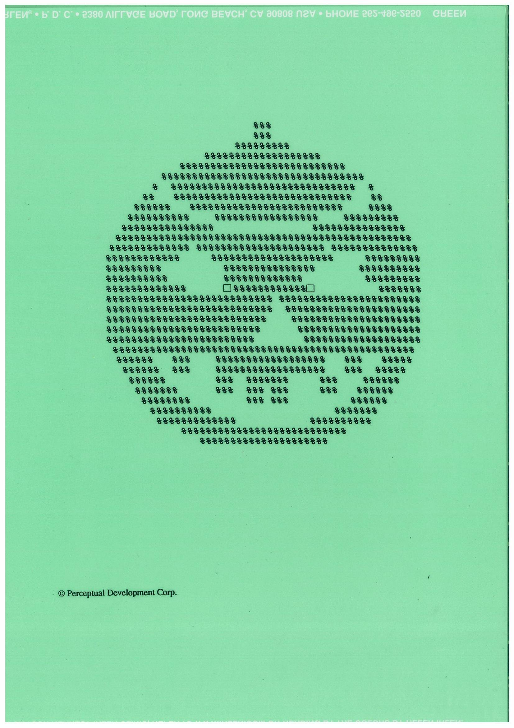

Slide 5
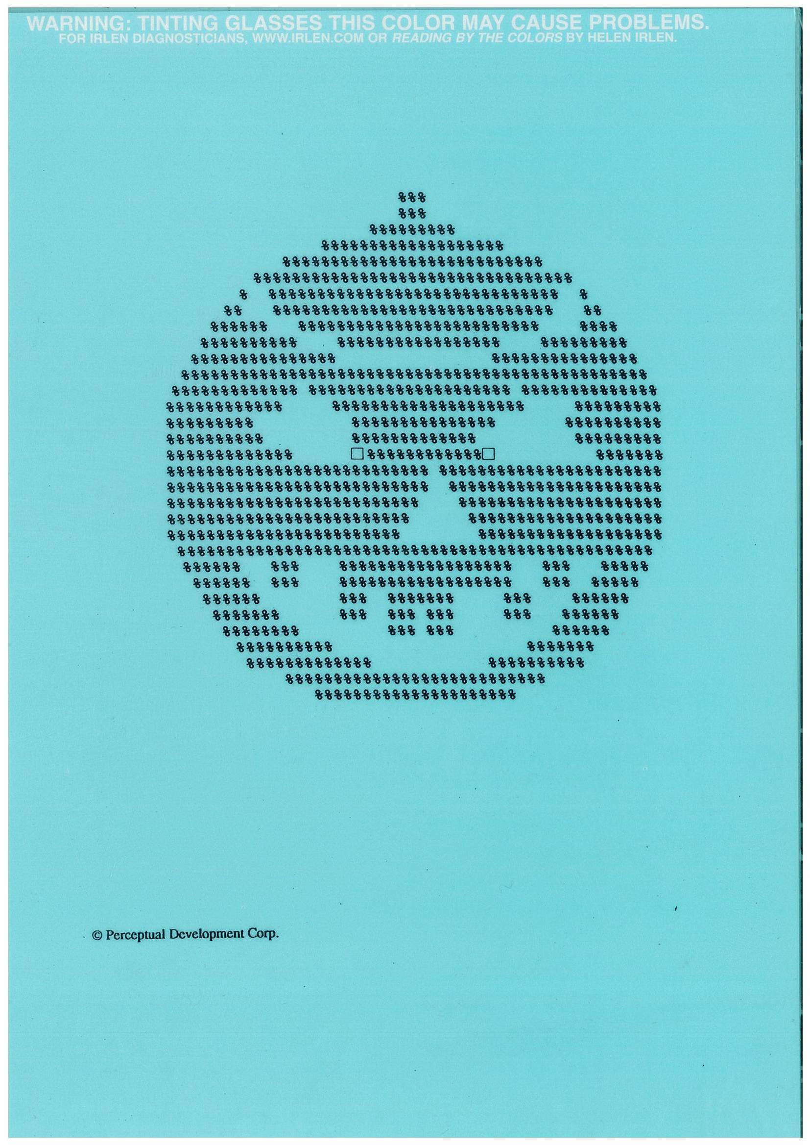

Slide 6
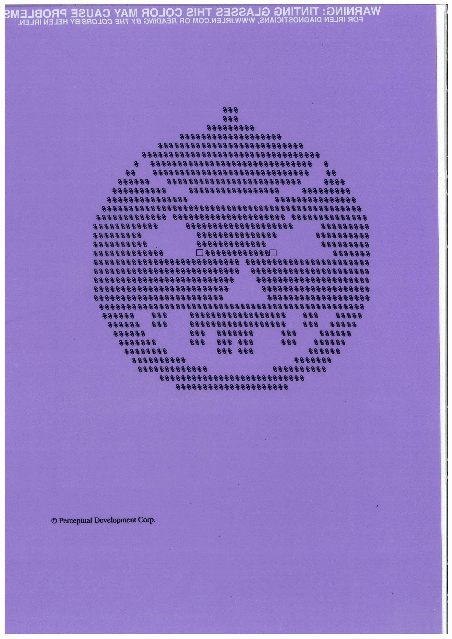

Slide 7


Slide 8
White or Colour?
What’s best for you?

Slide 10
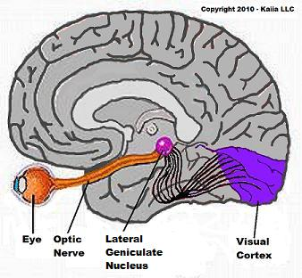

Slide 11
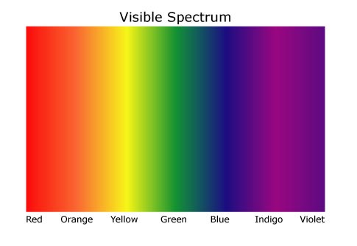

Slide 12
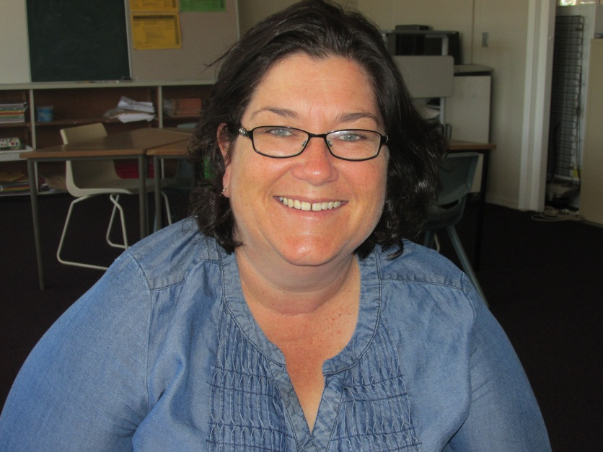
For one student the lenses were too dark and the child was constantly losing them, breaking them or just not wearing them.
Another one- I was watching a child cutting out on a straight line. She didn’t have her glasses on. She was looking and then she would stop shut her eyes and then shake her head. She then put on her glasses and you could see the look of relief/happiness cross her face. I asked her what had been happening and she said the lines were moving and kept going away from the scissors. Glasses stopped them doing it.
Nicole S –Year 6 Teacher

Slide 13
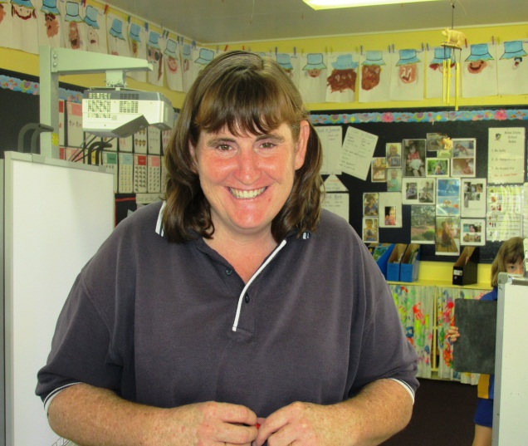
Because of Jo’s willingness to share her knowledge, enthusiasm and dedication, I have developed an interest and some understanding of Irlen Syndrome. I was fortunate to have the opportunity to undertake PASS training and have now completed a number of assessments. To have the opportunity to test your students who are struggling, despite having a commendable work ethic is so powerful! To have children describe the difficulties they are having with their vision is mind blowing! A child described how reading made his head feel a 1000 times heavier, which is why he would read with his head propped up in his hands. It had been considered a sign of refusal until he was empowered to share his story. Another detailed how the writing changed colours as she was trying to read. A third child explained how the difficulties she had, had been present the whole time, even when I taught her in Year One and at the point of testing she was in Year Five. I had been unable to identify what was blocking her ability to succeed at reading and she had been assessed by an optometrist and attended a block of $100 behavioural optometry sessions, with limited results. Having an understanding of Irlen Syndrome and having permission to undertake the PASS test is very empowering, for teachers and it benefits the students that I teach and those who are assessed.
Penny Donaldson – Prep Teacher

Slide 14
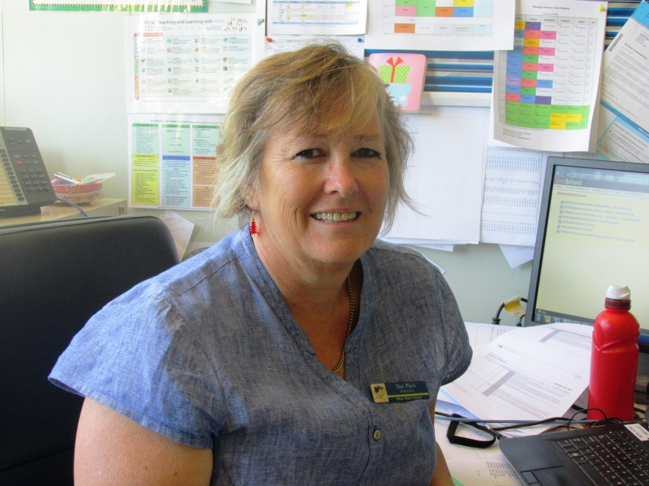
Some children reluctant to be tested.
Some not sure of what colour they had before the holidays, but adamant they still need an overlay… Some remembered after the holidays, others saying they need re-testing as the colour is not as effective.
A student when tested who could not look at the pumpkin shapes, and refused to try the overlays….
As a teacher, seeing the instant difference when a student being tested for IRLEN is easily able to read with a coloured overlay
Hearing teachers say they would like to be tested!!!
Sue Purs – Head of Special Education Services

Slide 15
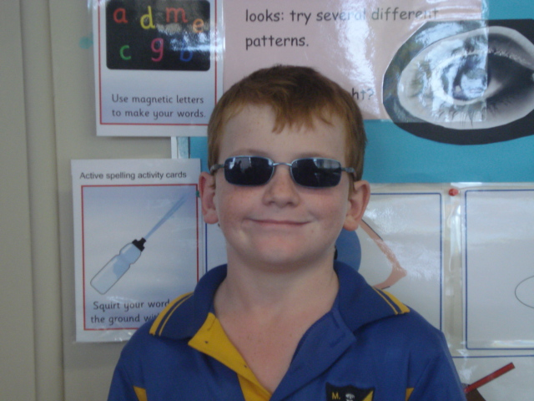
My son has progressed from reading well below level, to 1.5 years on, achieving an above average result for the PATR test undertaken in February, instead of the suggested September / October. He answered three questions incorrectly and couldn’t wait to share his results with us. He now reads for enjoyment. Last week I found my extremely active son in the library reading in his lunch break – never thought that would have happened.
Penny D.
Chris reports that before he got has glasses.
“It was hard to read because it was blurry”, “Hard to concentrate” and “I got lots of headaches”
Now- “Read and concentrate better”, “Don’t get headaches.”
“Like reading now!”
Chris – Year 5

