Slide 1

Whole School Approach to Irlen Syndrome
Presented by Jo-Ann Slater and Adam Myers of Miles State Primary School - QLD

Slide 2
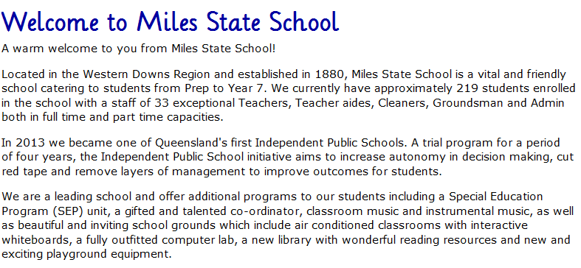

Slide 3
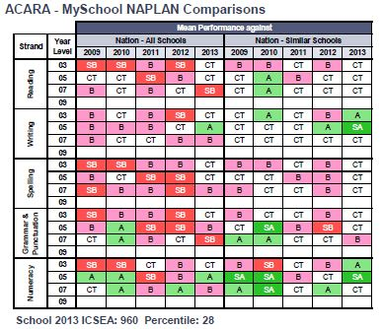
Miles SS NAPLAN 2009-2013

Slide 4
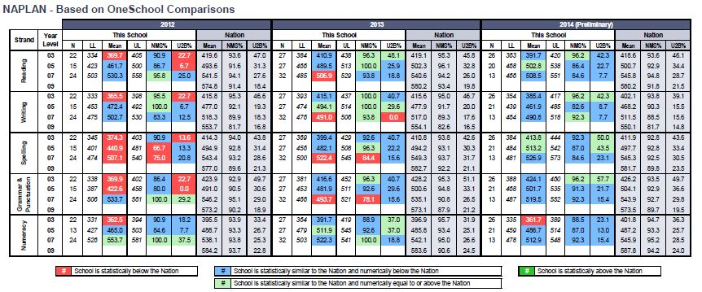
Miles SS NAPLAN 2012-2014

Slide 5
Year 3 Data

Slide 6
Year 5 Data

Slide 7
Year 7 Data

Slide 8
What Made The Difference?
Whole School Explicit Teaching Programs
High Impact Intervention Strategies
Whole School Irlen Project
Investment in Teacher Leadership
QELi Programs
Arrow Energy Support

Slide 9
Year 1 – 75%

Slide 10
Year 2 – 63%

Slide 11
Year 3 – 82%

Slide 12
Year 4 – 91%

Slide 13
Year 5 - 92%

Slide 14
Salford Reading Test –Gain/Loss

Slide 15
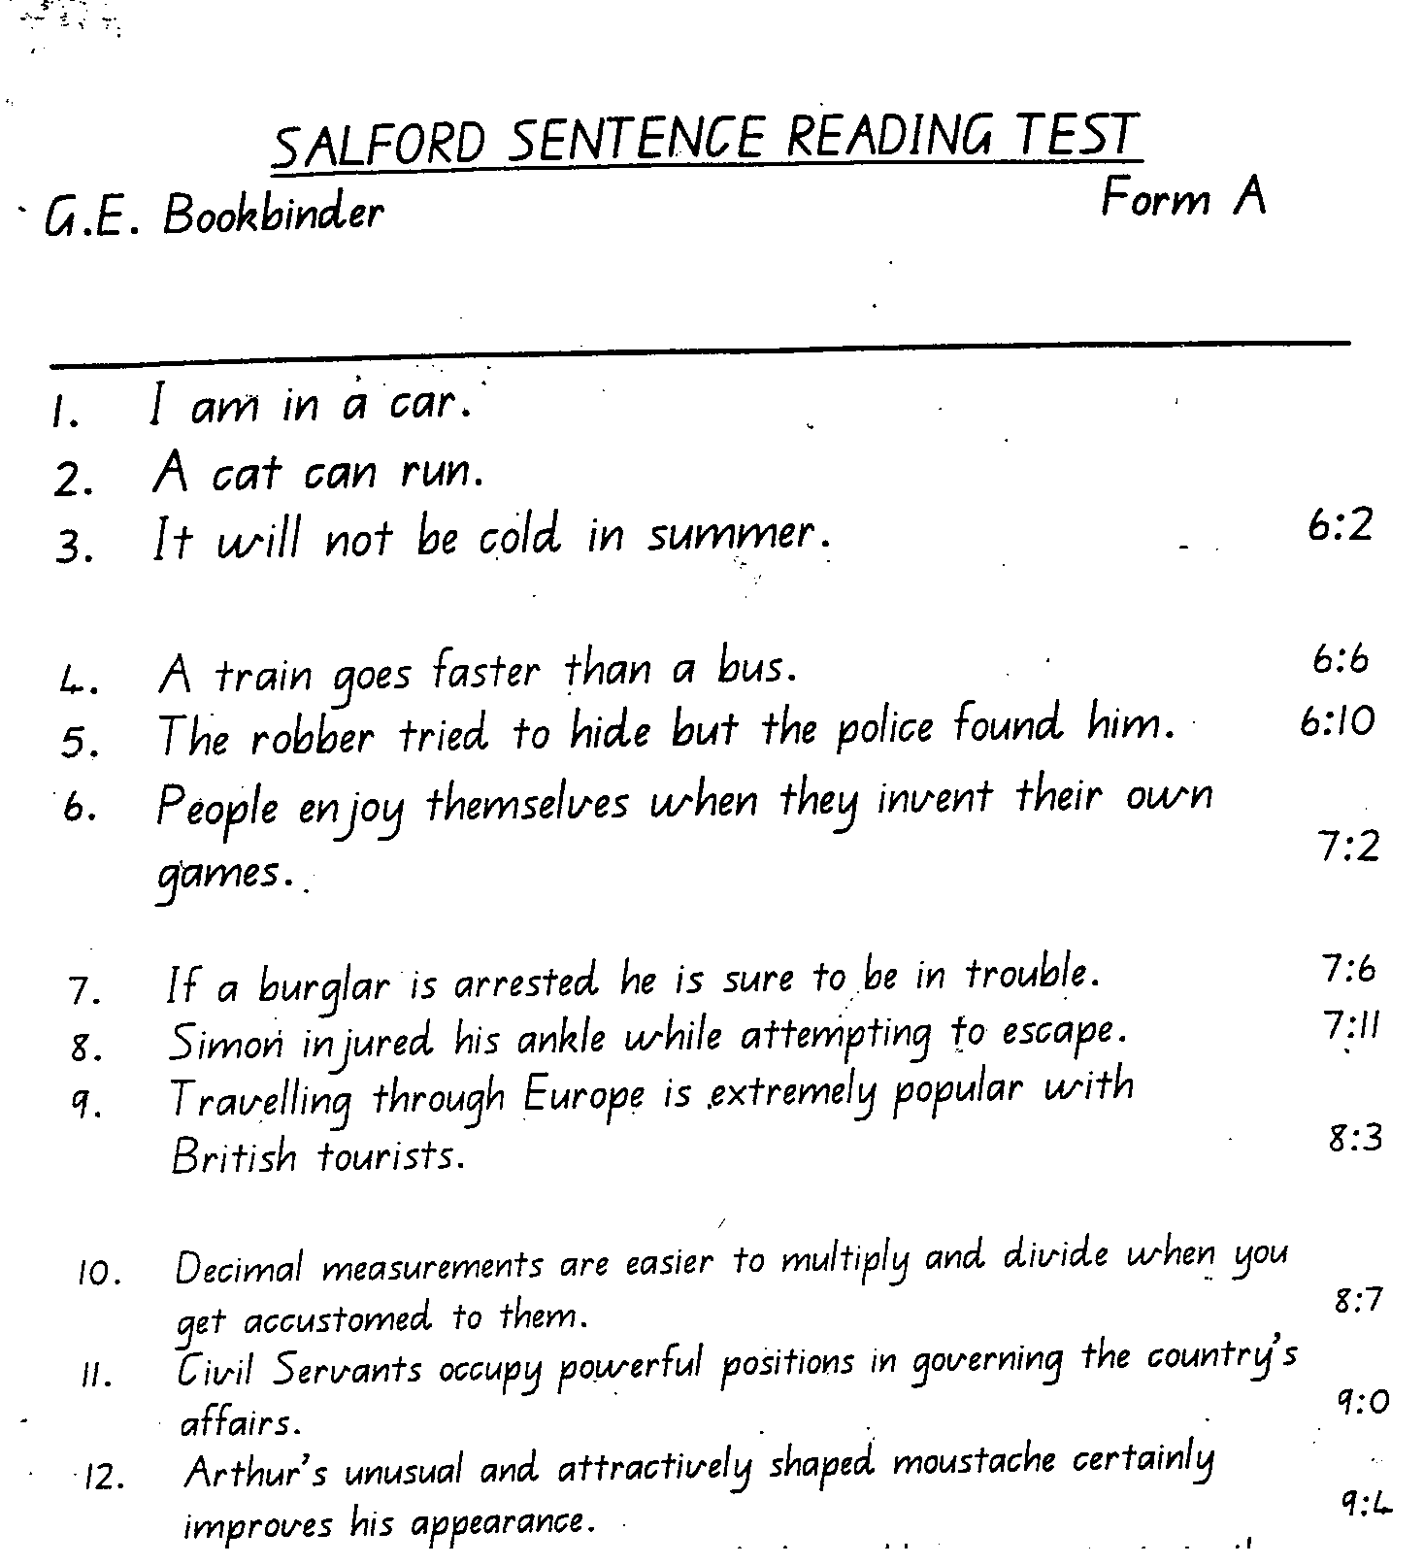
Pre- and Post Testing

Slide 16
Peter Freney’s Professional Development Overview- 13-14th August 2013
Dyslexia is a condition which affects 10-20% of the Australian population. Definition of the condition.
An overlapping condition exists called Meares-Irlen Syndrome, which is a visual processing disorder, sometimes referred to as visual dyslexia.
Each of these has its own distinctive set of characteristics.
Each needs to be treated differently. Brief outline of strategies that teachers can use that support learners who are dyslexic or have Irlen Syndrome (or both).
These children can learn but they learn differently.
Lack of recognition of these conditions will continue to manifest high literacy and numeracy problems and disaffected youth.
Parent Information Evening
PASS training

Slide 17
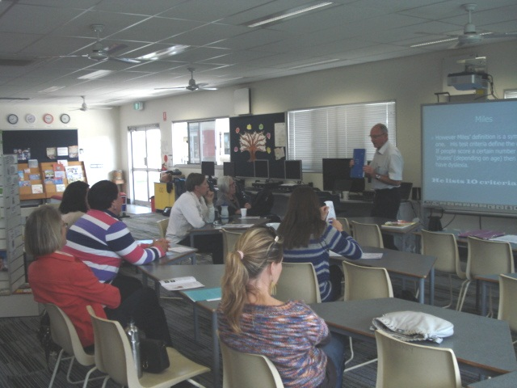
Parent Information

Slide 18
Kylie Bourne
"Sunnyview"
Miles Q 44
Ph-0467 17L225
Hon Christopher Pyne MP
PO Box 6022
House of Representatives
Parliament House
Canberra ACT 2600
12th August 2014
Dear Minister Pyne,
It is with pleasure that I present this letter of support not only as a teacher but also as a mother with children that have recently been diagnosed with lrlen.
I look back on my former teaching years and wish that I had been armed with the knowledge and understanding of the various dyslexia spectrums. I know there were many children under my teaching that could have benefited from potential interventions and support mechanisms to assist not only their learning but also their day to day functioning in the world, particularly in terms of lrlen.
From teacher to mother, I was becoming increasingly concerned particularly in relation to my daughters learning. I was at a loss as to what was really going on, as were my teaching colleagues and teaching friends. We had investigated a number of avenues to try and better understand what the issues were and got as far as knowing that is was a visual perception issue, however no real strategies or support tools were provided that assisted her.
Approximately twelve months ago we heard about lrlen and my children were pass test screened in our local school by a teacher we now have on staff that has the skills and training to undertake the screening. Both my son and daughter were captured through this process.
I quickly followed up to ensure they had the full screening and both now have their lrlen glasses and the results speak for themselves. I now have children that are not only achieving better results, but both are also much more settled and happier at school.
Miles State School now pass tests every student in the school as a screening mechanism for lrlen. As the only regional Independent School in Queensland we strive to achieve maximum outcomes for our students learning and life skills, A number of children in our school that have been diagnosed are now achieving stronger and more solid results, as well as being more confident young people
that are encouraged to learn and grow in the world around them.
In response to the positive outcomes for my children and our school, I recently submitted an application on behalf of Miles State School for funding through Arrow Energy for our region to undertake lrlen Training for teachers, and information sessions for parents and community.
These sessions are planned for early September, with many teachers from across the Western Downs and Maranoa Regions in western Queensland already registered to attend.
I cannot express strongly enough my belief that improvements, knowledge and understanding around Dyslexia and lrlen within Education are paramount to helping many of our children to grow into better functioning, educated, competent and capable individuals that can contribute to society and help our country to flourish into the future.
There are so many children that are currently slipping through the system, feeling discouraged and disheartened about themselves and learning in general. I wonder where we could potentially be as a country and in terms of societal balance if we offered our children with an opportunity to be screened and supported for Dyslexia spectrums and disorders if they have them.
I wish the lrlen Team well with their presentation to you at the Conference for Dyslexia and Teacher Training. I look forward to perhaps one day when our States and Territories embrace main stream screening of Dyslexia and lrlen in our educational facilities. The sky would then be the limit!
I would be happy to discuss anything further if required and am contactable on the mobile number above.
Yours sincerely,
Kylie Bourne

