Slide 1
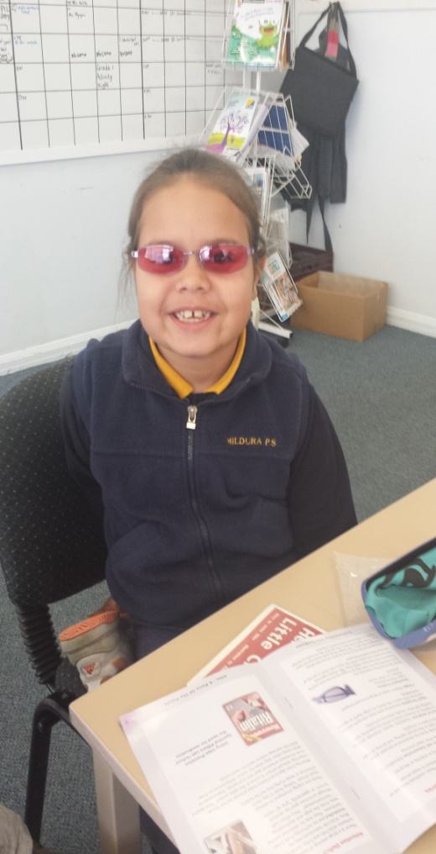
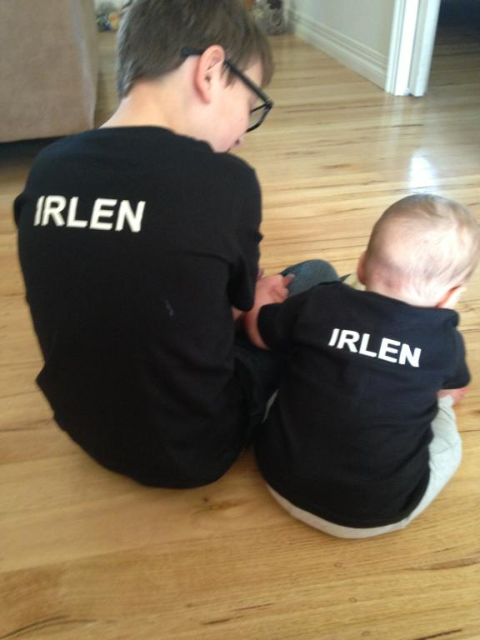
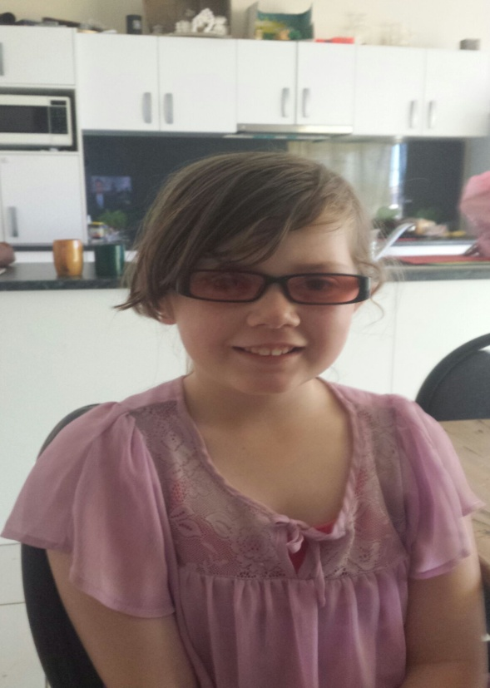
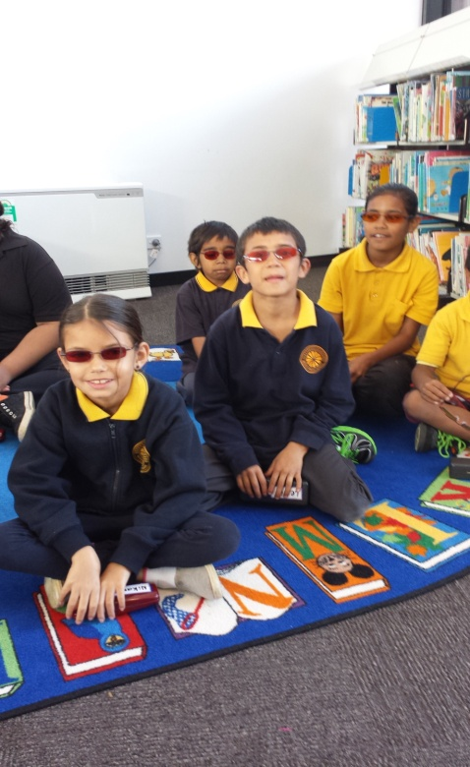
Mildura Irlen
Mildura Optical
Lower Murray Medicare Local
A Mallee Partnership

Slide 2
Recap:
2013 Irlen Australasian Conference
Indigenous clients
Assessed at three schools with high indigenous population - teachers’ recommendation
Found a huge need for Irlen

Slide 3
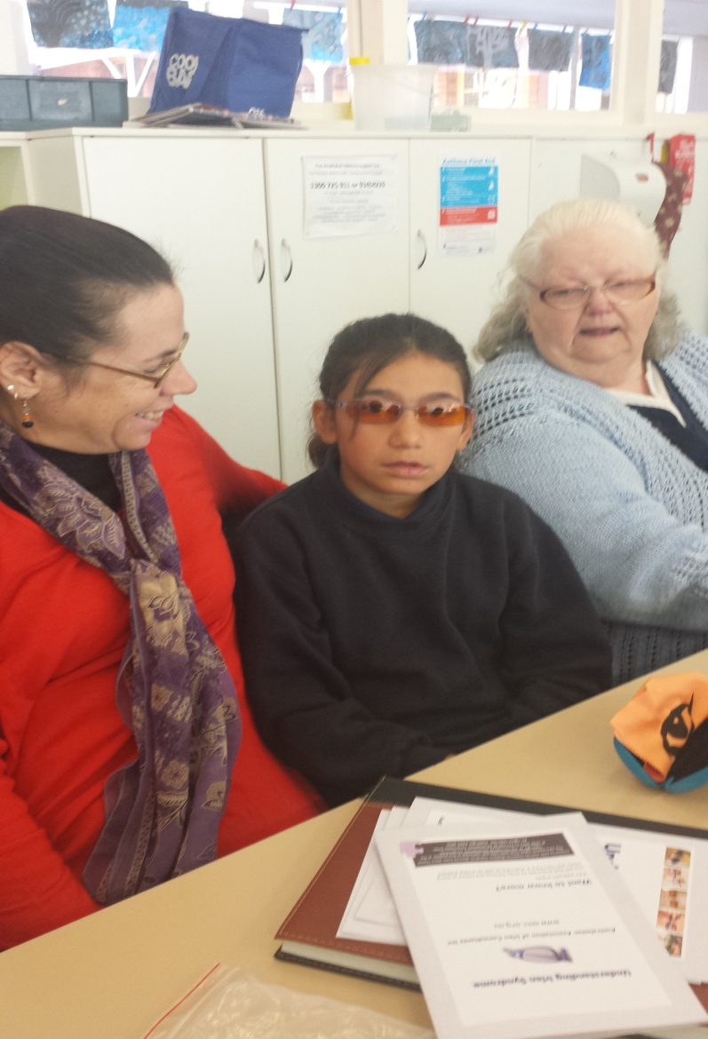
Main perceptual difficulties encountered
Glare
Very low literacy skills
Eyestrain
Fatigue
Behaviour
Unmotivated
Poor school attendance
Few had had optometric testing
Difficult home life

Slide 4
Need established........where to from here?
Funding
Helen Irlen
Aboriginal Cooperatives and Health Services Mildura, Robinvale, NSW
Welfare Agencies
Service Clubs
Interest some clients funded, but not a large number

Slide 5
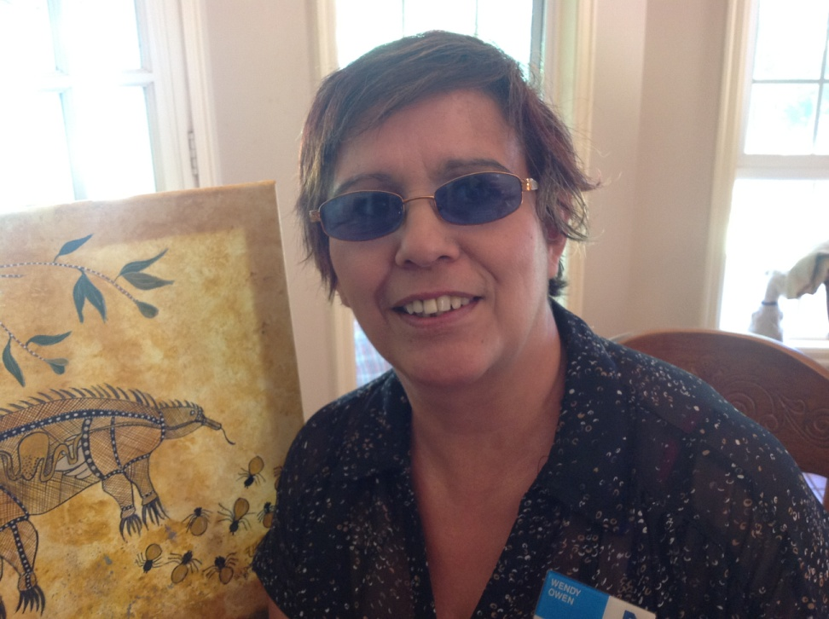
Enter......
Lower Murray Medicare Local
Koorie Worker at Lower Murray Medicare Local.
Really initiated the whole
Project.
Irlen Client
Letter written about her daughter.

Slide 6
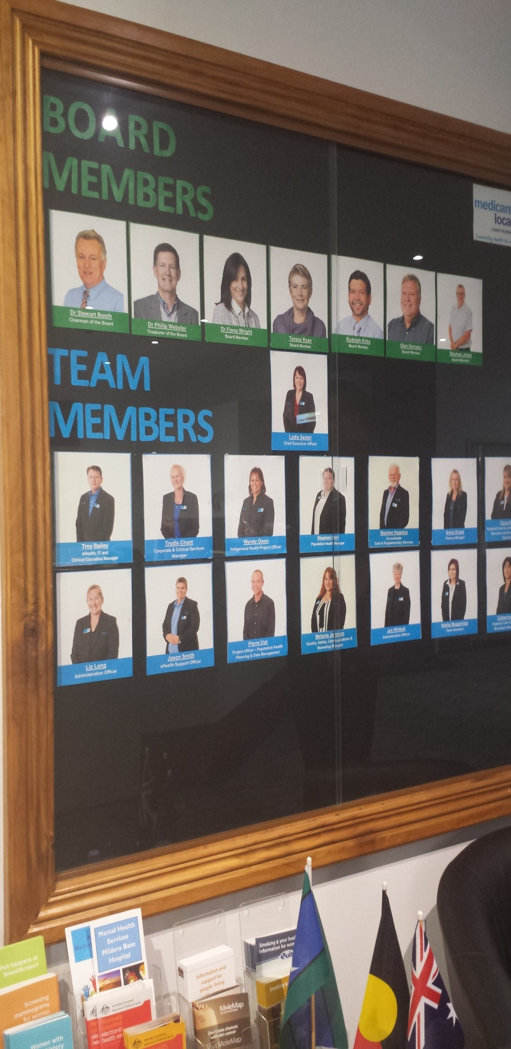
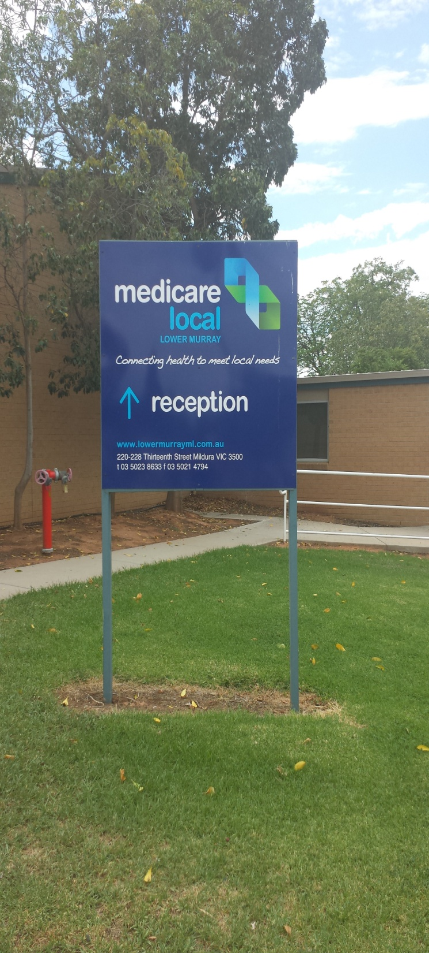
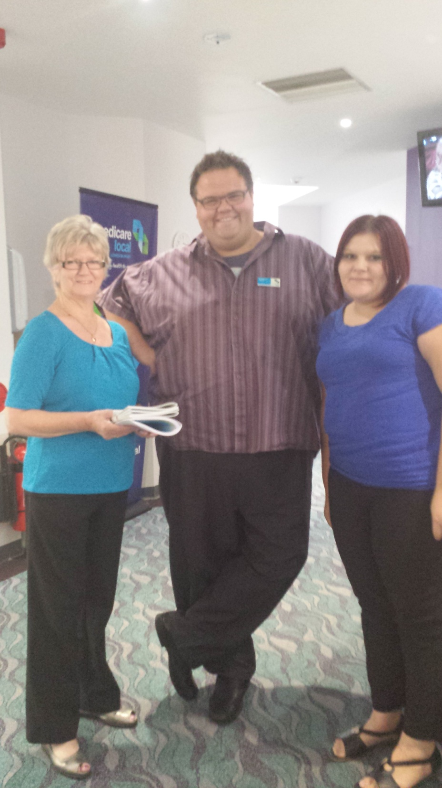

Slide 7
Sent this letter to her CEO
Money for Brain Trauma
Needed LOTS of statistics and data
Put a proposal together and tabled it
Accepted by the board of Lower Murray Medicare Local
Cheque of $9000 July 2013

Slide 8
Conditions
All students to have optometric assessment as well as Irlen assessment
Mildura Optical chosen
Costing
Reduced rate for optical assessment. Script and frames
Irlen cost did not include screening cost
Feedback documented

Slide 9
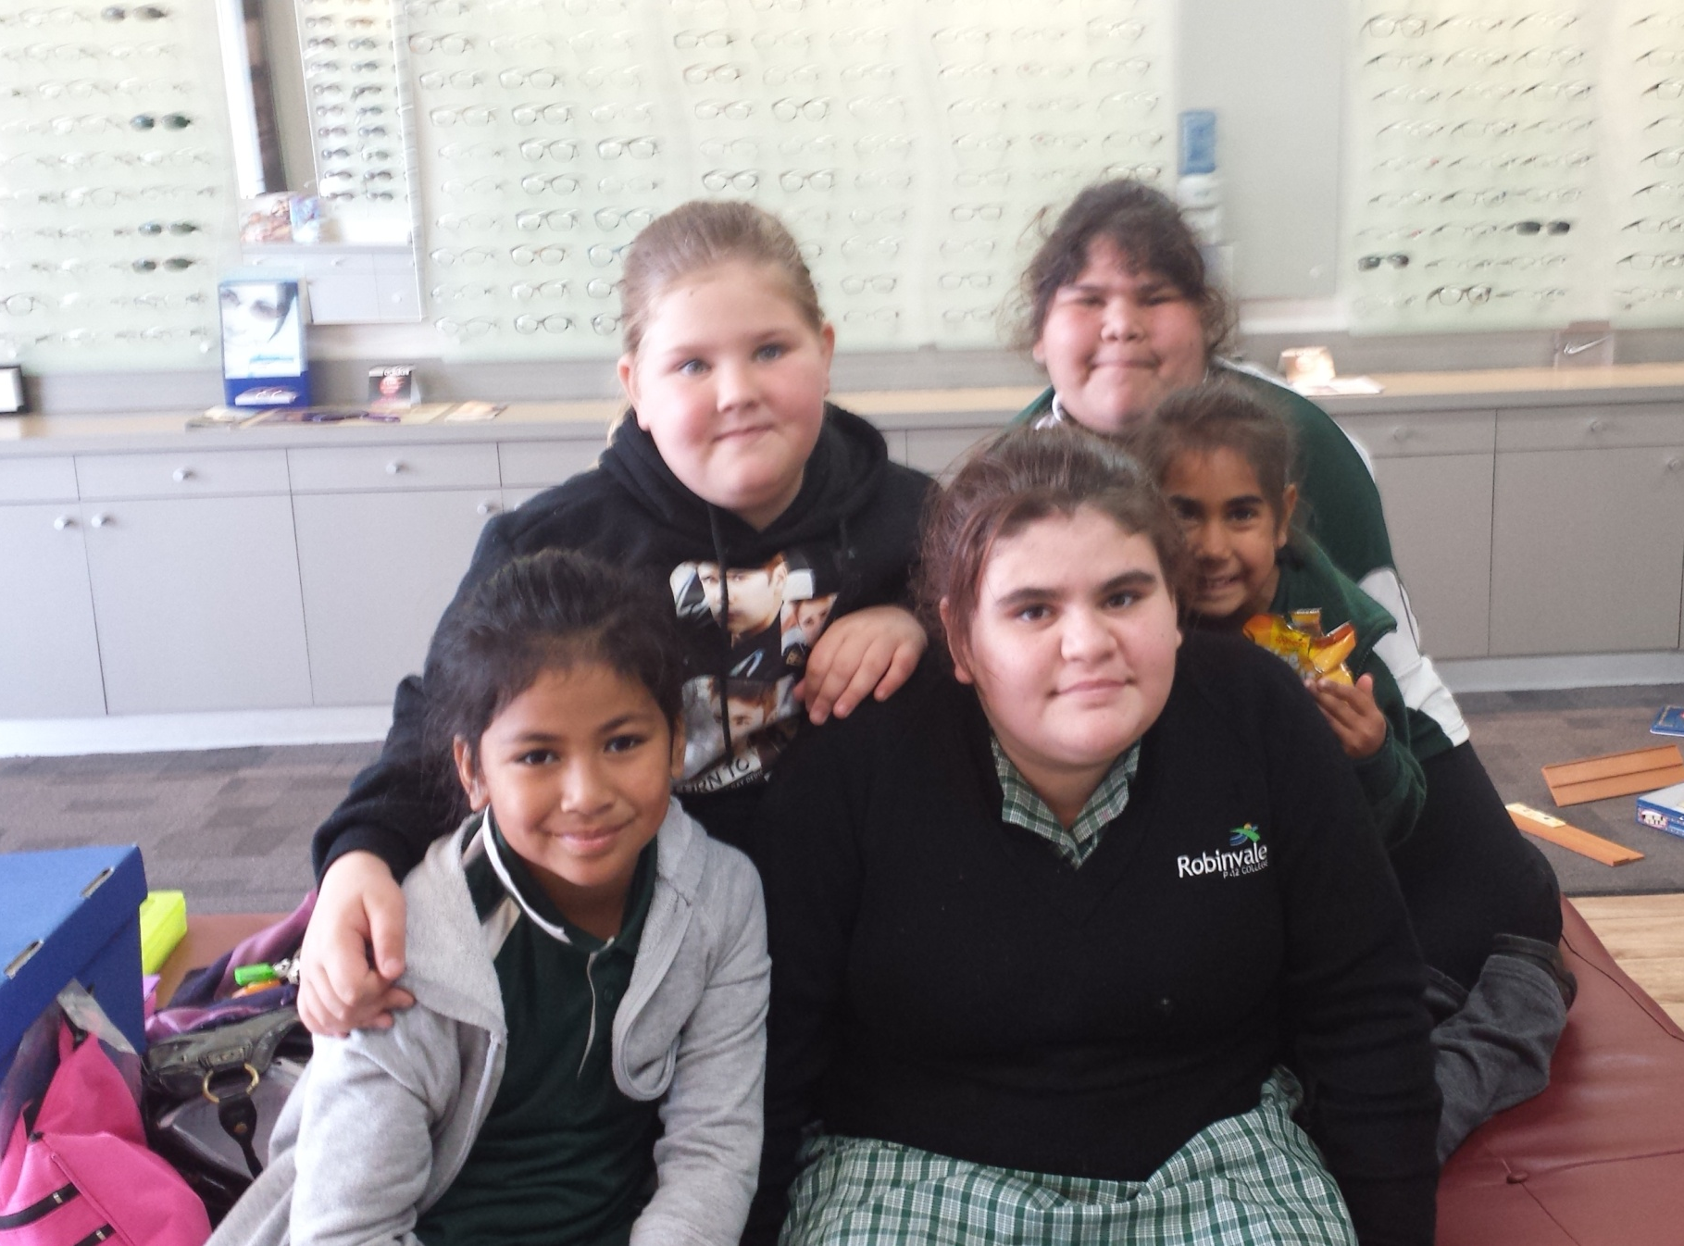

Slide 10
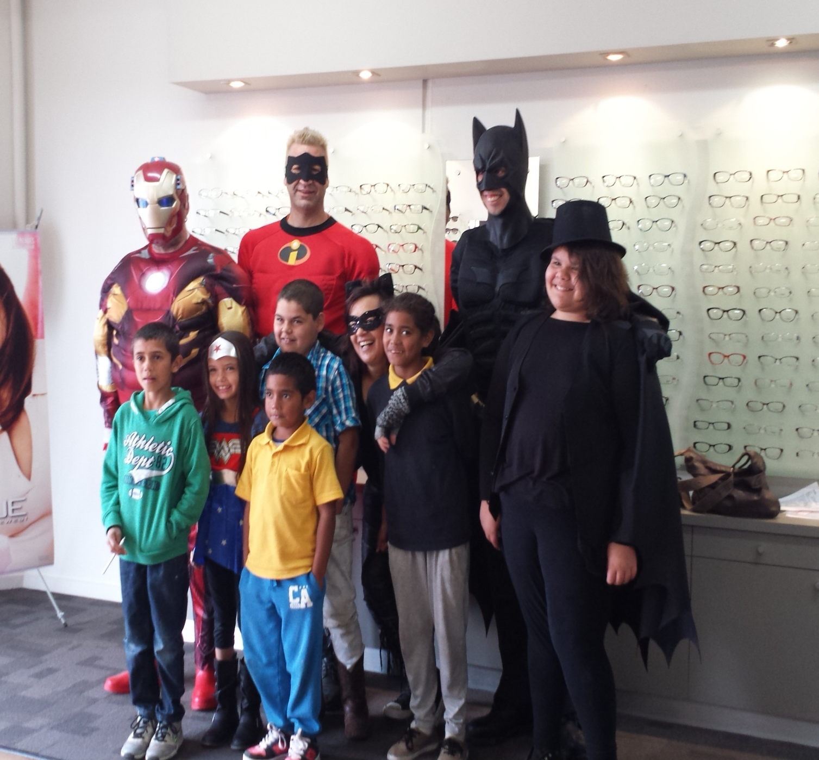

Slide 11
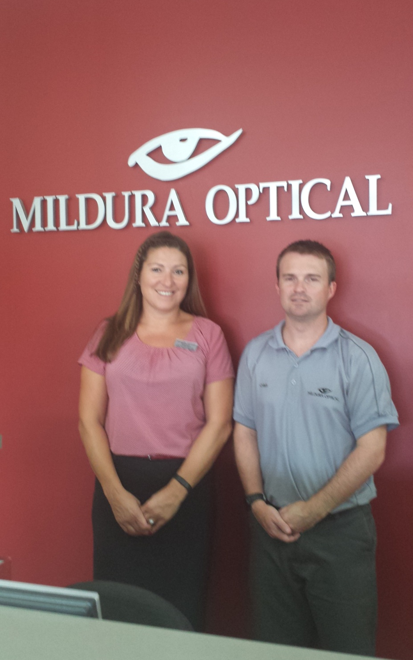
Publicity
Newspaper articles
Articles in school newsletters
Letters home for parents’ permission
Talk to staff and principals

Slide 12
How It Worked
1 Students wore their Irlen lenses all the time at school
2 Students did not take their Irlen lenses home
3 Students had to pay for overlays they used at home

Slide 13
Feedback for
Lower Murray
Medicare Local
Report on each student that received lenses
Feedback that included Neale Reading assessment,
questionnaire and one to one interview for each student.
Evaluation form for each teacher
Summary report given for each student
to Lower Murray Medicare Local
Completed in July and December 2013

Slide 14
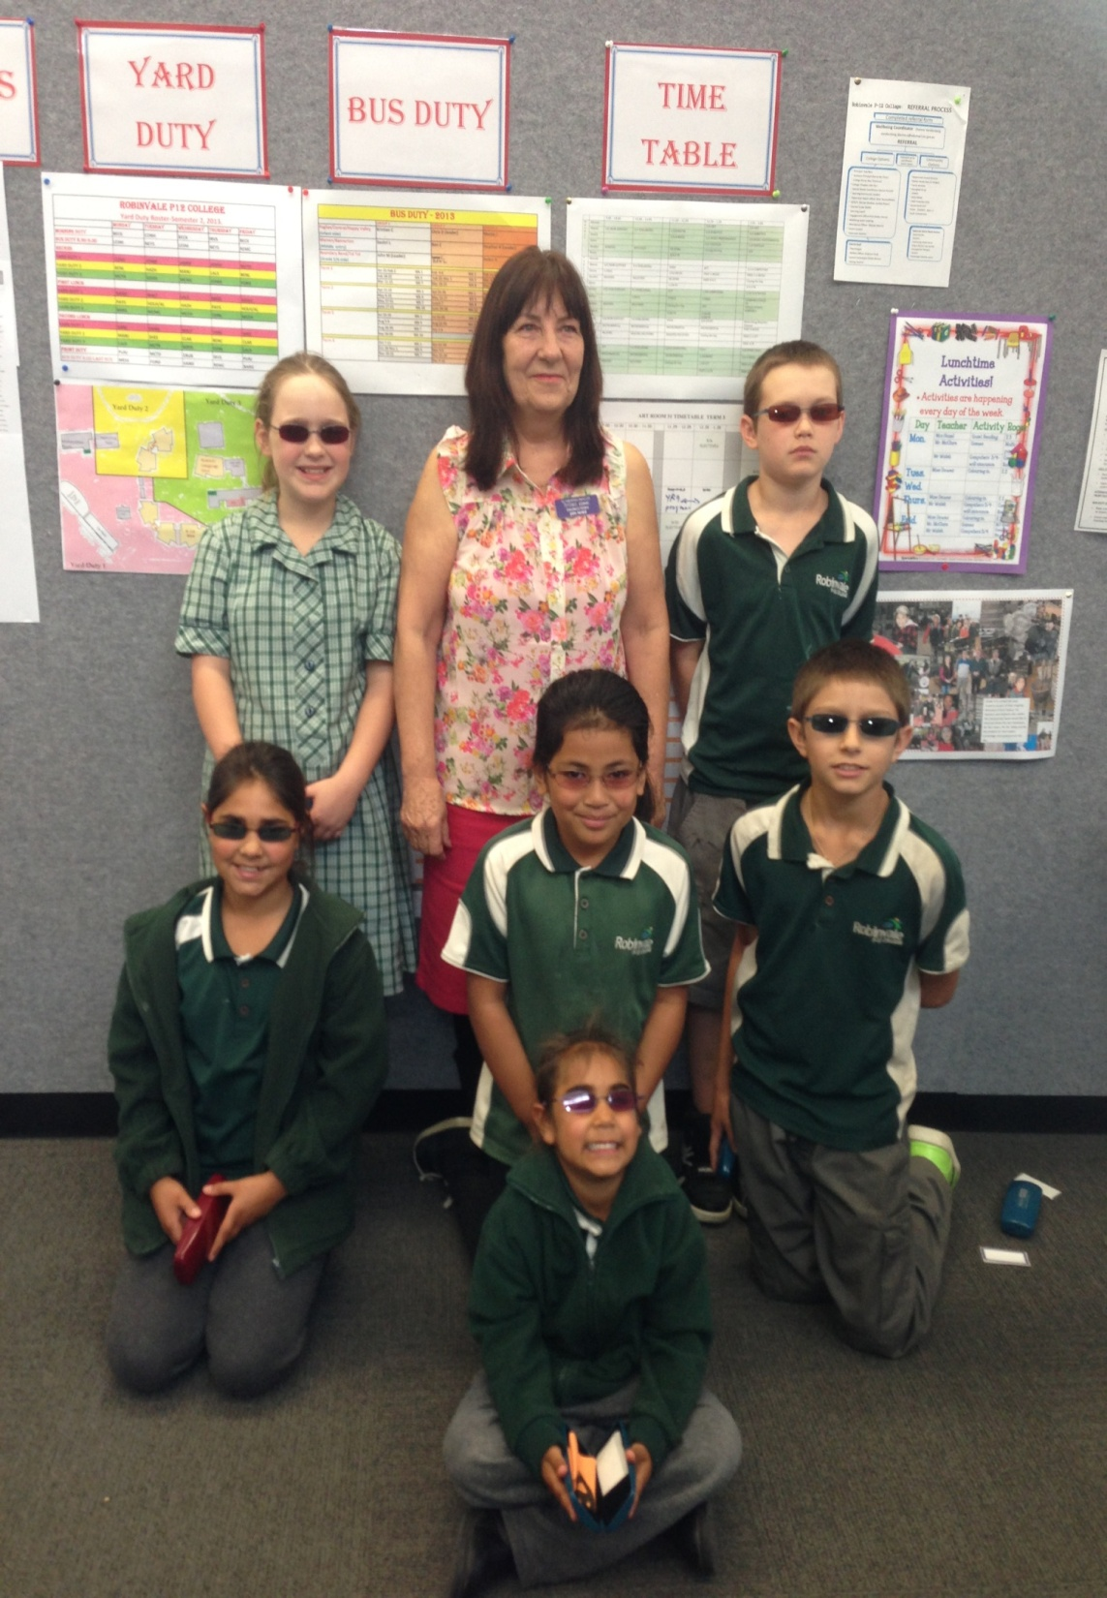
Robinvale P-12
Hi Jan
Thank you for sending these through to me. I was very interested to read of the progress the students have made since they wore their new Irlen lenses. The reports are very detailed and I appreciate the support you have given these students.
Ana Rees principal Robinvale P-12 College

Slide 15
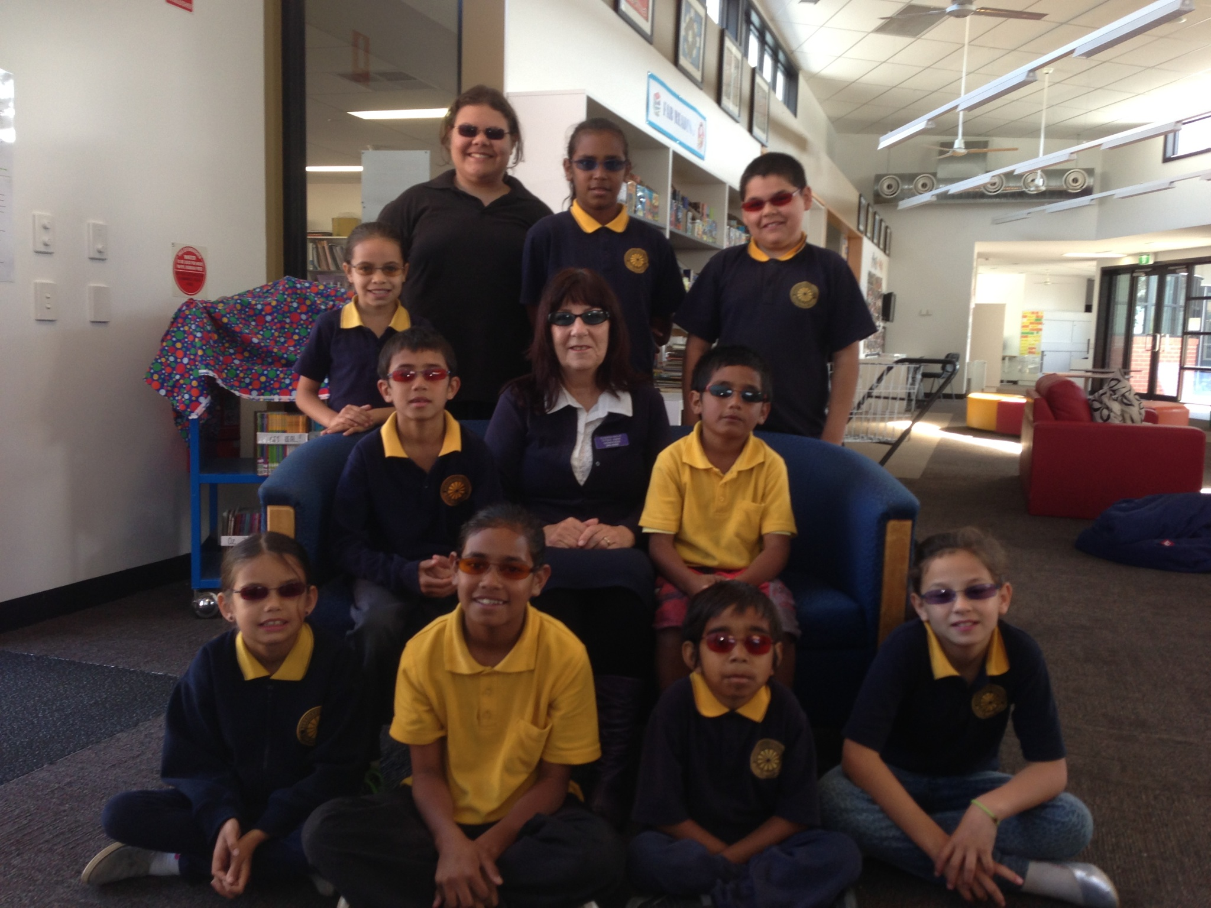
Thanks Jan. You have been very comprehensive in your feedback I will organise a feed back form for staff to fill in for you. Denis ( Principal ) and I think it would be helpful if you could talk to the staff about how the Irlen lenses support the children’s learning.
Sue McGinty
Vice Principal Mildura Primary School

Slide 16
February 2014 $20 000
More funding received.
This was to be available to a wider section
of the community.
Indigenous students
Other nationalities
Clinic clients
Health care card holders
Autism community
Adults could be included

Slide 17
Letters, proformas prepared for Funding
Prior to Funding
Letter to Medicare CEO Lydia Senior
Reports on students before lenses, after wearing lenses for a term, ongoing assessments to check progress. Given to teachers, Medicare Local
Neale Reading Assessments : ongoing
Layout of cost

Slide 18
Getting the Message Out there
Letters to Parents
Newspaper articles
Newsletter articles from Schools

Slide 19
Assessments
Questionnaire for students
Samples of student writing coloured paper if required
Samples of student spelling
Teacher evaluation of students progress, behaviours: noting change
Lower Murray Medicare Local Annual report

Slide 20
What progress has been made?
Helped 58 people and students in our community who would not have Irlen lenses or eyesight checked.
Whole network of support opened up through Medicare Local,
part of their annual report, support to help them stay open in another format.
Much more awareness of Irlen became the
norm in Mildura Primary and Robinvale P-12

Slide 21
Other schools in the district have come on board.
Referrals from Optometrists and other Health Professionals.
Many more on the Autism spectrum seen.
Asked to talk to many groups: schools, Medicare Local, U3A.
Broken Hill Centacare funded 8 out of work adults.
Many enquiries about Medicare Local funding in other areas.

Slide 22
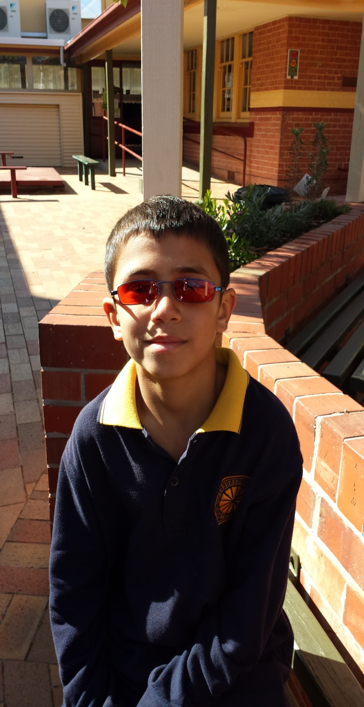
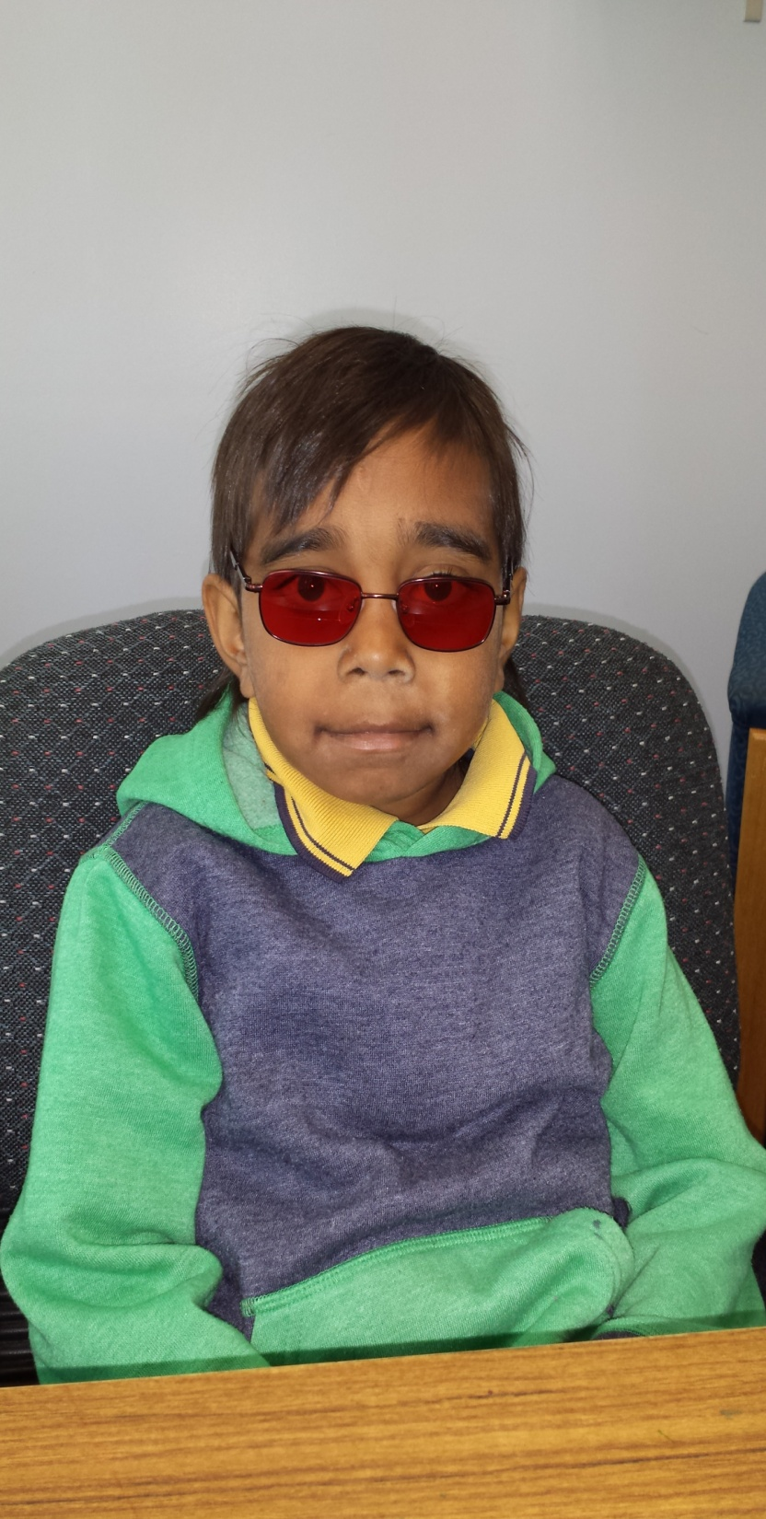
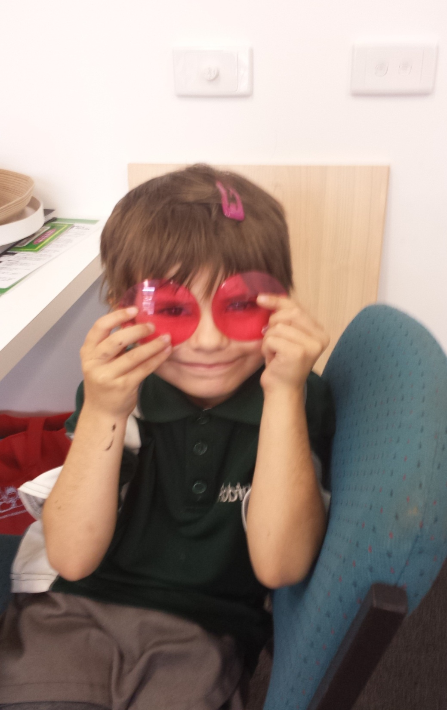

Slide 23
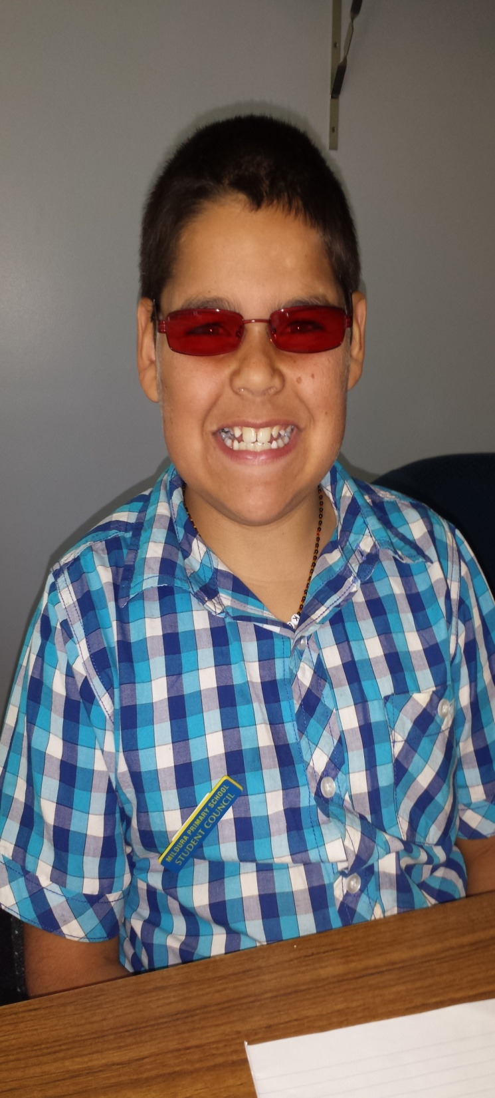
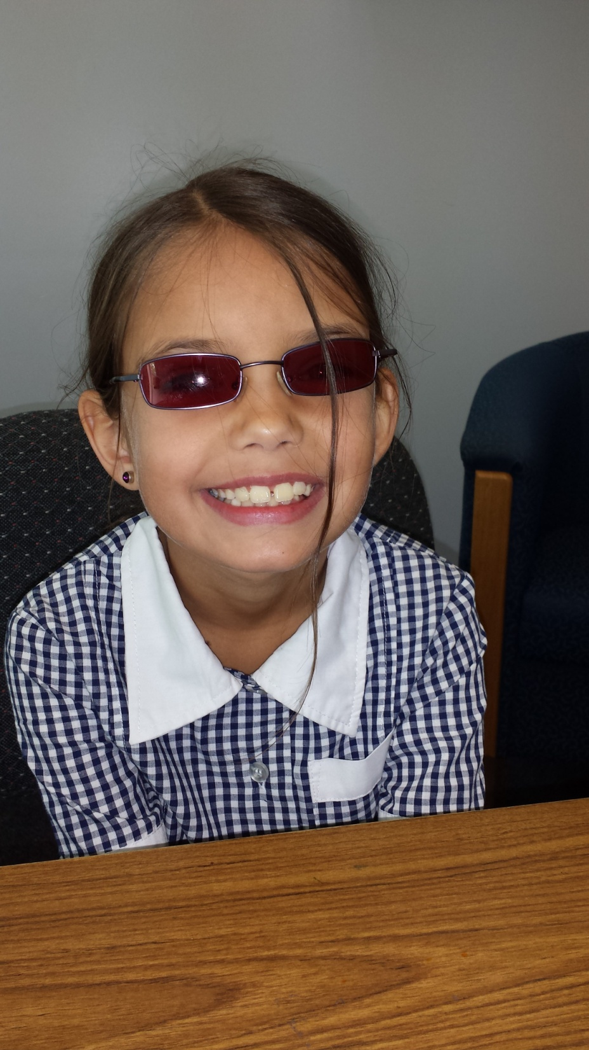
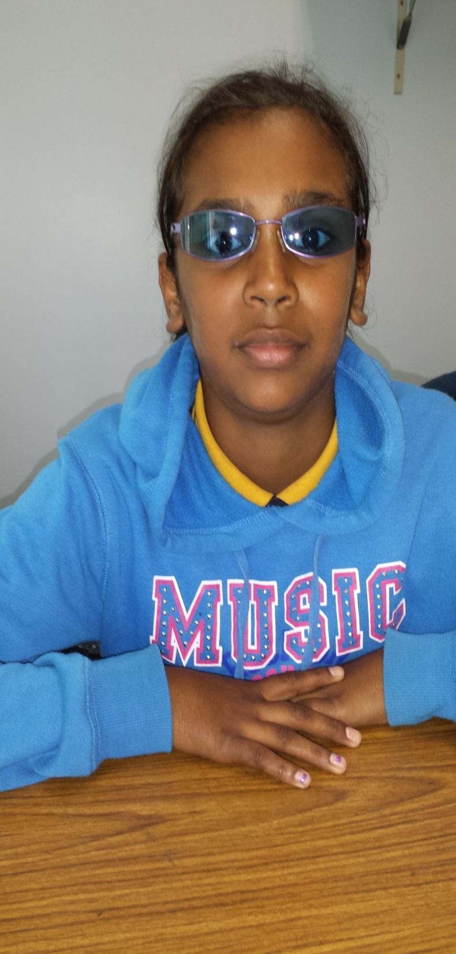

Slide 24
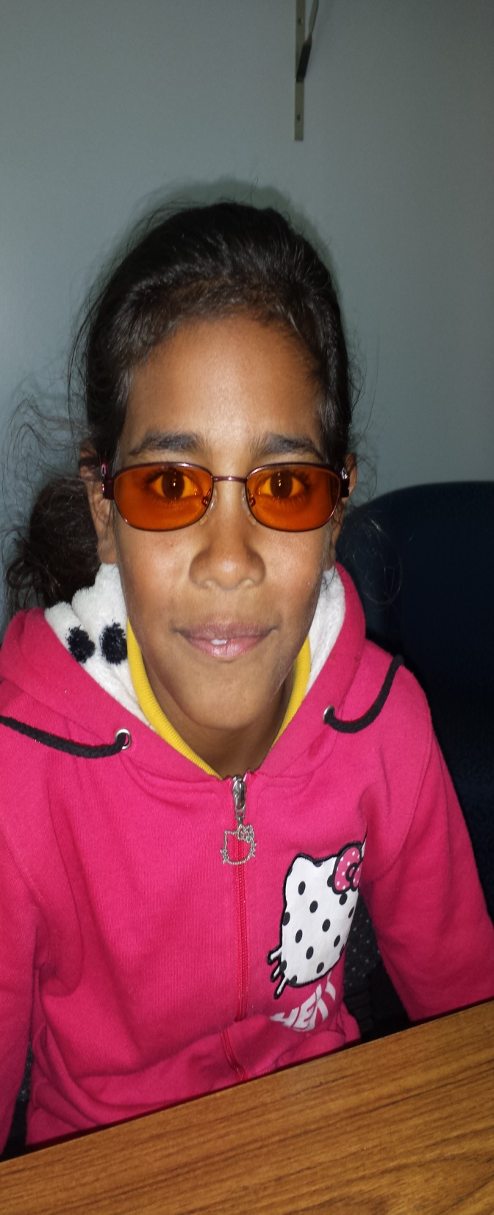
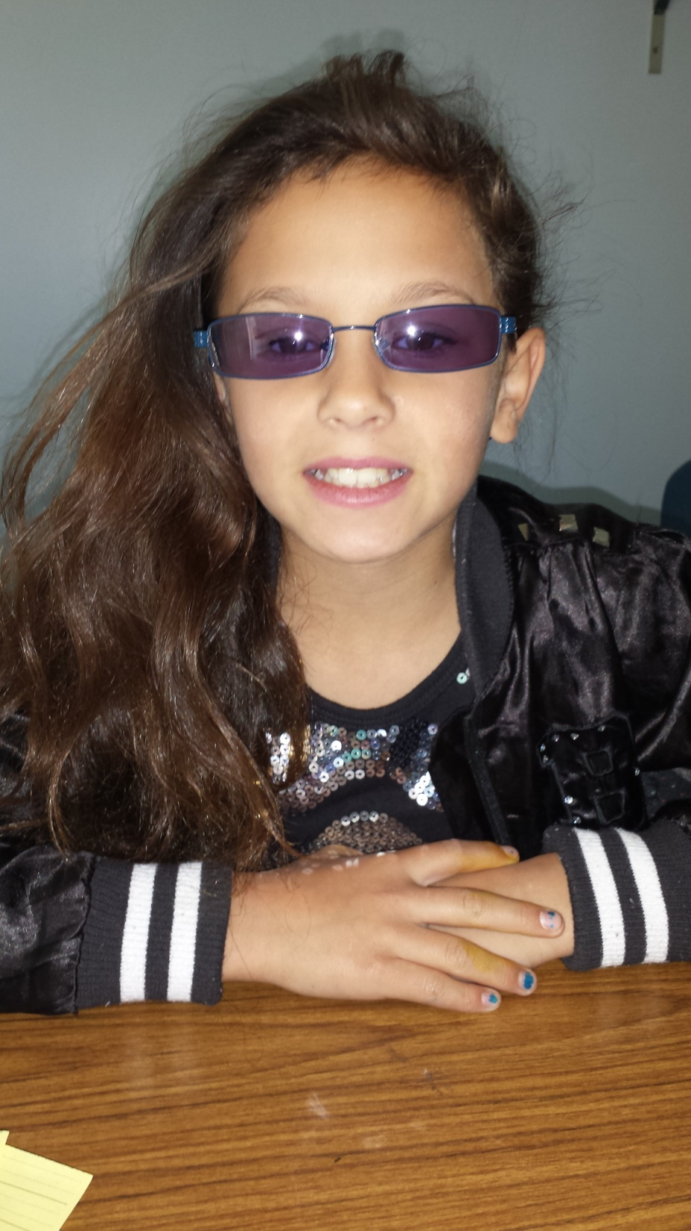

Slide 25
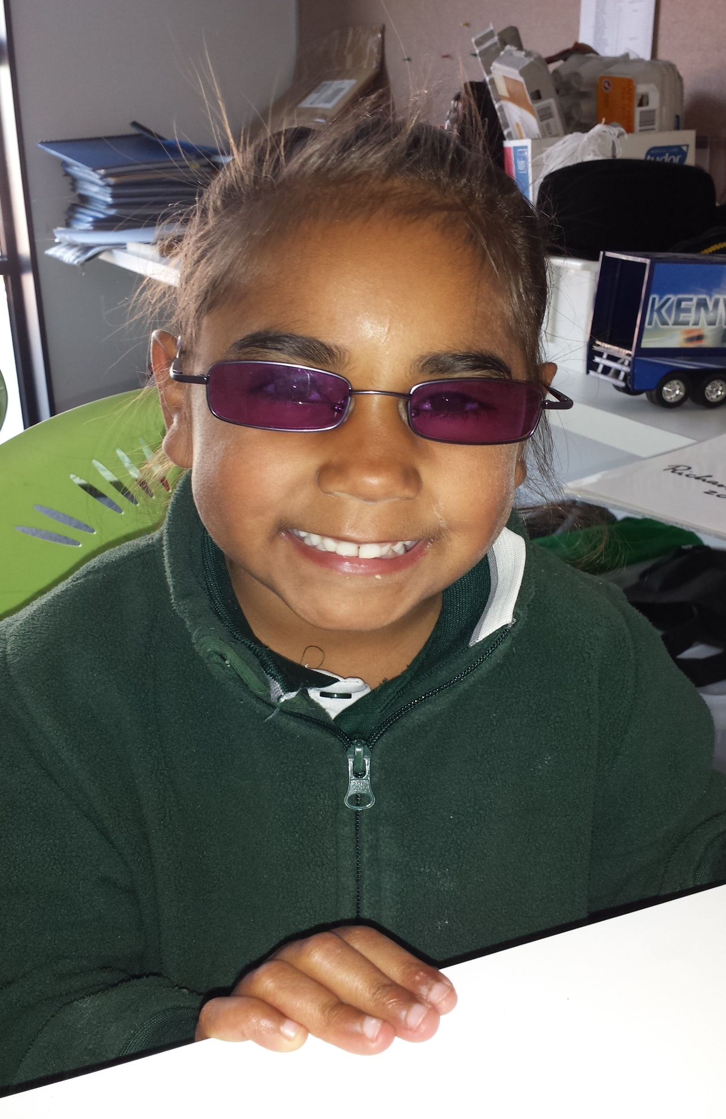
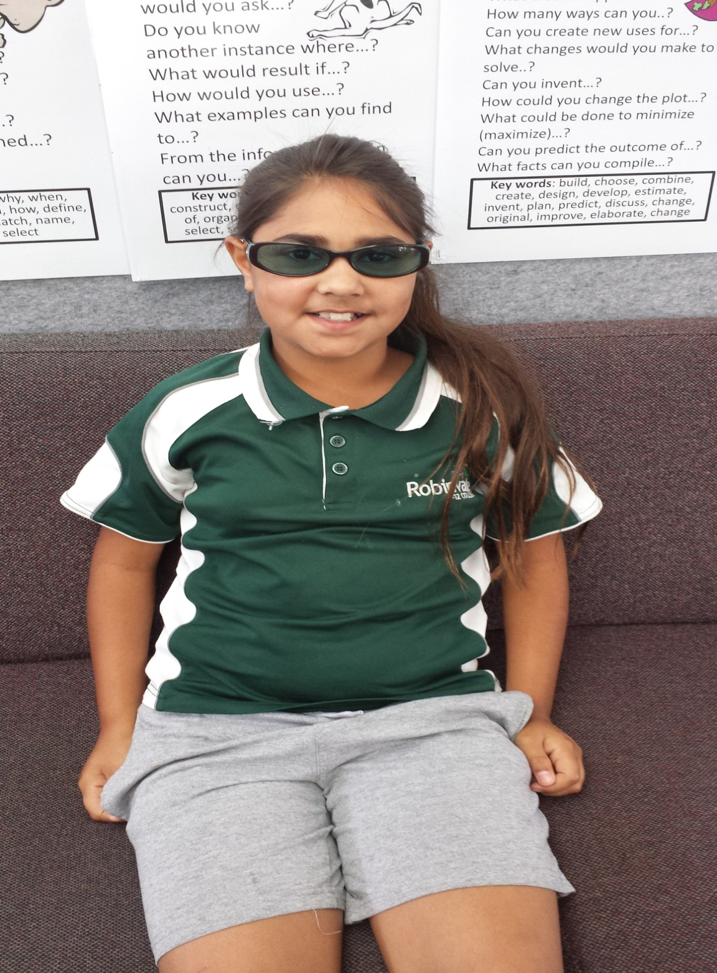
Sisters

Slide 26
Our current research has shown that Irlen Syndrome affects high numbers in the Koorie community and the Tongan and Samoan communities.
The Mildura Irlen Clinic is able to give students a coloured overlay and good teaching strategies for their teachers.
However, we cannot “give” students the lenses or complete a full assessment without payment. So many of these needy students are missing out and cannot achieve their full potential or break out of the cycle of generational poverty.

