Slide 1
Being ‘different’
Impacts on identity, self-esteem and wellbeing
Dr Liz Temple
Faculty of Health, Federation University Australia
e.temple@federation.edu.au

Slide 2
Overview
Being ‘different’
The self
Development of self-concepts & wellbeing
Early childhood
Middle childhood
Adolescence
Supporting positive self-development

Slide 3
Being ‘different’
Irlen-Meares Syndrome is an ‘invisible’ difference – unless coloured glasses are worn, or accommodations made (e.g., large print, extra time, etc)
Children/adolescents may be reluctance to wear their glasses or let people know about their condition
Not wanting difference to be visible
Fear of stigma resulting from being identified as ‘abnormal’
Potential and reality of teasing or bullying
Feelings of discomfit, embarrassment and/or shame related to difficulties
Developmental drive to be accepted and liked by peers
Fitting in means being similar to others
Being different is only okay if it’s viewed as an enhancement (e.g., excelling at sport) rather than a deficit or oddity

Slide 4
The Self

Slide 5
The Self
Sense of self is continuity between the lived past, the experience of the present, and the anticipated future
Psychosocial identity
who you perceive yourself to be
your values, attitudes and opinions
what you do, think and feel
personality
Self-knowledge
Declarative knowledge - the facts and impressions that we consciously know and can describe
Procedural knowledge - knowledge expressed through actions rather than words

Slide 6
Declarative self-knowledge
All of your conscious knowledge or opinions about yourself
Self-esteem: an overall opinion about whether you are good or bad, worthy or unworthy, or somewhere in between
Self-schema: your beliefs, memories, and generalizations about yourself
Can be broad and over-arching or narrow and context-specific
Self-efficacy: your beliefs about the degree to which you will be able to accomplish a task or goal, if you try
Domain specific
Possible selves: the beliefs you have about the other possible ways you might be or should be

Slide 7
Self-Discrepancy Theory
Discrepancies between possible selves and the actual self lead to psychological distress
Ideal self: beliefs about who/what/how you could be at your best
Can be positive or negative, realistic or unrealistic
Small discrepancies can be motivating
Large discrepancies are associated with feeling of failure, low self-esteem, and depression
Ought self: beliefs about what/how you should be
Internalised beliefs about how you should behave, what you should be able to do and achieve
Discrepancies are associated with feeling guilty for ‘inappropriate’ behaviour, worries about being ‘found out’, and anxiety

Slide 8
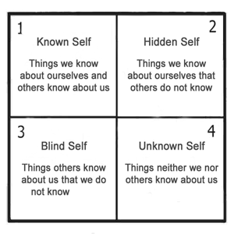
Procedural self-knowledge
Your characteristic patterns of behaviour
driven by things of which you are not typically consciously aware
ingrained ways of thinking and feeling about yourself, the world and other people
usual patterns of interactions with our environment and other people
behavioural ‘scripts’
Johari window
(Luft & Ingram, 1955)

Slide 9
Development of Self-Concepts & their association with Wellbeing

Slide 10
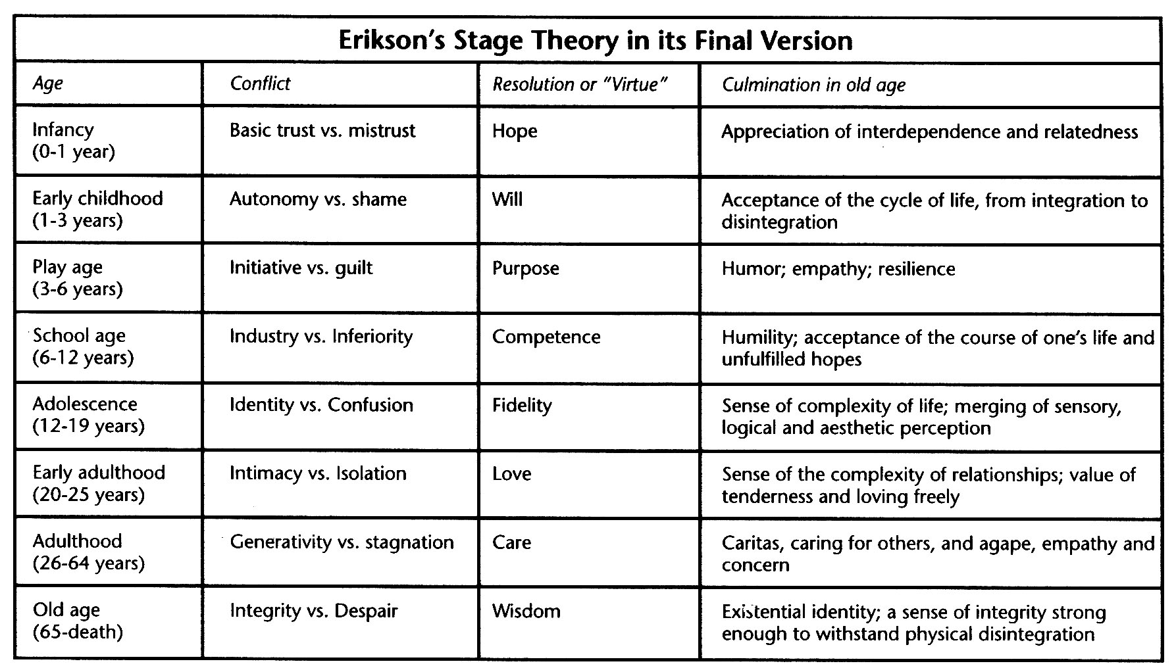

Slide 11
Early Childhood
Trust vs. mistrust (birth – 1 year)
Autonomy vs. shame & doubt (1 – 3 years)
Initiative vs. guilt (3 – 6 years)
Attachment Theory
(Bowlby & Ainsworth)
Lays the foundation for social & emotional wellbeing throughout life
Does not generally change substantially from childhood without intervention
Type of care | Attachment orientation
Warm, responsive and consistent care | Secure
Inconsistent care – passive or intrusive | Preoccupied/Ambivalent (high attachment anxiety)
Emotionally distant and insufficient care | Dismissing/Avoidant (high attachment avoidance)
Extreme and erratic care – neglectful, abusive or overly intrusive | Fearful/Disorganised (high anxiety & avoidance)

Slide 12
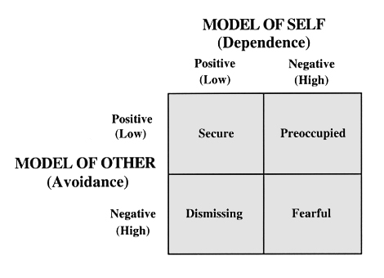
Securely attached individuals tend to feel positively about themselves and other people, and to view the world to be a generally safe place
Ambivalent
Avoidant
Disorganised

Slide 13
Secure attachment
Warm, responsive and consistent caregiving during early childhood
child’s needs are met
views people as being reliable, caring and trustworthy
able to develop good interpersonal relationships with others
child feels safe in physical environment
enables child to explore and learn
develops feelings of self-efficacy and autonomy
child feels valued
develops feelings of self-worth, belonging and feels loved
positive core beliefs/self-schema and self-esteem develop

Slide 14
Core beliefs/Self-schema
Core Belief | Positive state
Value | I am worthy
Security | I am safe
Performance | I am competent
Control | I am powerful
Love | I am loved
Autonomy | I am autonomous
Justice | I am treated justly
Belonging | I belong
Others | People are good
Standards | My standards are reasonable and flexible

Slide 15
Outcomes associated with secure attachment
Individuals with a secure attachment style are more likely than those with an insecure attachment style to:
have good social skills & high emotional intelligence
are flexible & constructive in their interpersonal relationships
demonstrate compassionate feelings and values
are responsive to others and engage in altruistic behaviours
utilise functional coping strategies when stressed
have lower anger-proneness, report more adaptive responses in anger episodes & attribute less hostile intent to others
have lower levels of risk for depression, anxiety & burnout
(Kafetsios, 2003; Mickelson et al., 1997; Mikulincer, 1998; Mikulincer & Sheffi, 2000; Ognibene & Collins, 1998; Pines, 2004; Priel & Shamai, 1995; Simmons et al., 2009)

Slide 16
Middle Childhood
Industry vs. Inferiority (6 – 13 years)
Children have a sense of pride in their accomplishments and abilities, such as those associated with learning
Success leads to development of feelings of self-efficacy and increased self-esteem
Encouragement from teachers and parents is important, reinforcing self-belief, initiative and goal setting
Lack of encouragement leads children to doubt their abilities and undermines their confidence in attaining goals
Accuracy of feedback is important
Self-knowledge and self-esteem are shaped through feedback
Children are learning to calibrate efforts vs. outcomes
Mismatch affects motivation, engagement, and identity development

Slide 17
Impact of Irlen-Meares Syndrome
When a child starts school, they are typically keen to learn – especially to read and write. They listen in class, following the teacher’s directions, and try their hardest. They work at home with their parents on sight words, home readers, writing and spelling lists.
If they have a Irlen-Meares Syndrome, they are likely to see
their peers advancing through the readers to books with more words, while the child struggles to make sense of the shapes on the page, looking to the pictures to ‘read’ the story
their peers writing faster and more neatly, with more ease and fewer errors, while the child gets some letters the wrong way round and is marked wrong when spelling a word the way it sounds
their peers getting praise from the teacher, while the child gets little or negative feedback, being told to put in more effort, to be less sloppy, to pay more attention
their peers being able to decipher things written on the board, moving quickly from task to task, while the child gets sore, tired eyes and headaches and seems to always have to ask a friend what they are supposed to do next

Slide 18
Impact on the child
When a child struggles to learn and develop skills at the same pace as their peers they may feel:
that they are ‘stupid’ or ‘dumb’, because no one else seems to be having difficulty
embarrassed or ashamed of their struggles & poor performance
frustrated, because they are trying so hard, but nothing works
angry when they are told to try harder, because they know they are already trying their hardest
helpless, because nothing they do makes a difference
hopeless, because they can’t imagine things improving

Slide 19
Impact on the child
The child might:
act-out, becoming disruptive in class
withdraw, becoming subdued and unobtrusive
persist, seeking and accepting support in their efforts to learn
The behaviour engaged in by each child will be influenced by many factors, including the:
severity of condition and problems encountered
classroom environment/climate – teacher & peers
parental support
child’s personality, attachment orientation & pre-existing core beliefs
these can be changed by the school experience

Slide 20
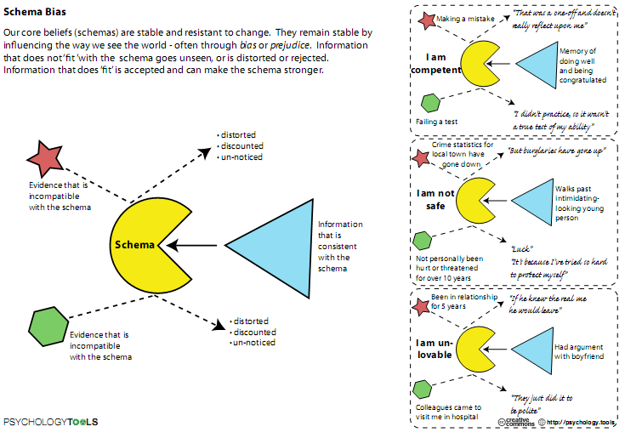

Slide 21
Adolescence
Identity vs role confusion (13 – 19 years)
Adolescence is a time of transition
Growing independence
Puberty hormones, changing bodies
Increased social complexity
Peer acceptance becomes increasingly important
Being viewed as ‘different’ can be harder
Academic expectations and pressures increase
Difficulties and limitations can become harder to negotiate
Period of identity exploration prior to commitment to adult identity
Working out who they are, what they value, what they think, what they will do in adult life, how/who they want to be
A multitude of possibilities but also a multitude of uncertainties

Slide 22
Identity status (James Marcia)
Commitment
Yes No
Identity Achievement
Identity Moratorium
Identity Foreclosure
Identity Diffusion
Exploration
Yes
No

Slide 23
Identity styles (Michael Berzonsky)
Commitment
Informational
Active exploration of possibilities
Normative
Doing what is expected by others
Diffuse/
Avoidant
Rejecting of norms, but not exploring options

Slide 24
Identity style & wellbeing
Participants
N =243, 18-29 years (M = 22.41, SD = 2.62), 75% female
45% single, 29% non-co-habiting relationship, 25% married/de facto
47% students, 26% employed FT, 24% employed PT/casual
Measures
Identity style: ISI-4 (Berzonsky et al., 2010)
Psychological distress & wellbeing: MHI-18 (Ware et al., 1984)
 | Psych Distress | Psych Wellbeing
Informational | -.29*** | .38***
Normative | -.07 | -.09
Diffuse/Avoidant | .28*** | .15
Commitment | -.34*** | .28***

Slide 25
The Identity Foreclosure group was found to have significantly higher levels of Anxiety (ƞ² = .06), Depression (ƞ² = .07) and Loss of Behavioural & Emotional Control (ƞ² = .10) and significantly lower levels of Positive Affect (ƞ² = .09) than the Identity Achievement group.
No differences in age, education, relationship status, but significantly higher proportion of males in Moratorium group (ƞ² = .05)

Slide 26
Supporting positive self-development

Slide 27
Supporting positive self-development
Actions that will assist in preventing the child’s experience of learning difficulties from becoming central to their self-identity, undermining their self-esteem and adversely affecting their feelings of self-worth include:
Encouraging and supporting efforts
having a ‘red-hot’ go, but understanding limitations
aiming for personal bests and gradual improvement, not comparing to performance by others
Support the development and maintenance of their feelings of autonomy, competence, connectedness and self-esteem
provide opportunities and environments where they can engage in activities they enjoy, find interesting, where they can achieve
must be challenging, providing opportunity for skills development, but manageable – balance between skills and difficulty

Slide 28
Self-Determination Theory Deci & Ryan, 1980
Basic Psychological Needs
Autonomy
Competence
Relatedness
The need to experience self-direction & personal endorsement in the initiation and regulation of one’s behaviour.
The need to be effective in interactions with the environment
The need to establish close emotional bonds and attachments with other people

Slide 29
Psychological Need Satisfaction
Individuals with high levels of autonomy, competence and relatedness are more likely than those with low levels of these qualities to:
have high levels of psychological wellbeing & positive affect
have lower levels of risk for depression, anxiety & burnout
be intrinsically motivated, have enhanced self-motivation and self-regulation
thrive at school and work
engage in prosocial behaviours
have a secure attachment style
(La Guardia et al.., 2000; Ryan & Deci, 2000; Ryan et al., 2008; Van den Broeck et al., 2008)

Slide 30
Supporting positive self-development
Talking about diversity to normalise difficulties
everyone is different, has different strengths and weaknesses
everyone struggles with something, finds other things easy
Identifying and nurture their strengths
both school-related and in other areas of life
help them to discover how they can apply their strengths in every-day life
Encouraging understanding that having Irlen-Meares Syndrome and experiencing difficulties does not define them, nor dictate their present or future
Reframing experiences to nurture optimism and build resilience
Encouraging a growth mindset

Slide 31
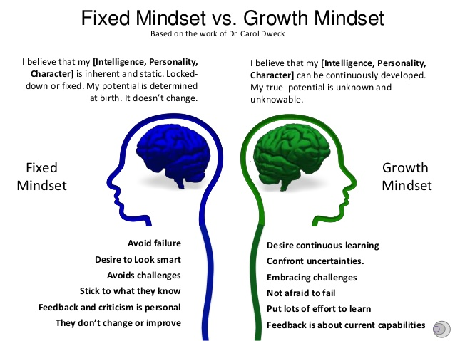

Slide 32
Negotiating daily life
Ensure the child understands the condition, how it affects them and how their glasses and/or other accommodations help
Knowledge about what to expect, limitations, etc.
Allay fears and misconceptions
Help them to develop an appropriately detailed explanation that they can provide to other people – e.g., peers, teachers
Ensure needs are met, accommodations made, at school and home
Discuss strategies for avoiding/dealing with problems if/when they occur
Resting eyes, sitting near the window, avoiding glare, etc.
How to calm themselves if they become anxious or frustrated
What to do if a peer teases or bullies them
Help them to become ‘scientists’ – trying new approaches to find out what works best for them in different situations

Slide 33
Questions?

